Slide 1
Evidence based advocacy for health How we do it in Iran?
Nastaran Keshavarz Mohammadi
Associate professor, Health Promotion
Shahid Behehsti University of Medical Sciences, Tehran
Kermansha, 1394

Slide 2
Presentation at a glance
1- What?- Definitions: (Evidence based advocacy for health , Health, Advocacy, Evidence-based, Evidence )
2- Why? (Goals and principles and values)
3- How? (Process and requirements)
4- Personal assessment and reflections (How well do we do it: the way forward)

Slide 3
Evidence based advocacy for health
The conscientious and explicit use of current best evidence in
advocacy efforts for health.
A process which integrates otherwise independent data from
different sectors: research, policy, action groups, clinicians,
practitioners etc., into an analysis to inform advocacy for
health.

Slide 4
What is advocacy? What efforts can be considered as advocacy?
A skill /competency
Advocacy is about taking action to change something, to gain support for
something , speaking out for something for better life
The process of standing alongside an individual who is disadvantaged, and
on their behalf in a way that represents the best interests of that person
Decision makers at different level are main target of advocacy
A necessary competency and responsibility for every individual, community

Slide 5
Advocacy for health
Advocacy as a necessary core competency and responsibility of all health professionals
Any efforts that change environmental conditions or create new conditions ( policies, process, delivery of services, resource allocation, structures , support, culture, norms, beliefs , practices) in favor of health ,
With focus on less advantage people

Slide 6
Ottawa Charter

Slide 7
Why does health need advocacy?
People can not fully protect their health, so they need support to
succeed, and their health needs to be protected .Why they can not?
Because, health (at any level of individuals, group, community,
setting or society) can be influenced, negatively or positively by
individual or environmental conditions.
Political, economical, social, cultural, environmental as well as
biological factors and conditions can favor or harm health.
Health might be misunderstood or neglected by people and/or
decision makers. (a false understanding: you can be health if you want!)

Slide 8
Many possible roles in advocacy for health (Gordon 2002)
representative role (speaking for people)
accompanying role (speaking with people)
empowering role (enabling people to speak for themselves)
mediating role (facilitating communication between people)
modelling role (demonstrating practice to people and policy-makers)
negotiating role (bargaining with those in power)
networking role (building coalitions)

Slide 9
The “science” of advocacy for health
Good understanding of health and its complex determinants
Good understanding of target audience and the context
Good knowledge of how to change people or make change
Good knowledge of communication, collaboration, partnership
Systems level structure and capacities (skilled professionals, networking, scientific resource, transparencies, values and rules, access to evidences
Are we ready? Is our science advance and up to date?

Slide 10
The art of advocacy for health
Requires skills ,Good intention is not enough!!!
Good skills of evidence mining, appraisal and appropriate utilization
Message development
Delivery of the message
Working with media
Building partnership
Leadership
How is the sate of our advocacy art? Do we own required sills?

Slide 11
Effective and convincing advocacy
Required data to build the rational
Epidemiological data, behavioral data, social data
Health care data ,trends
Knowing Key stakeholders and their interest , available resources and capacities
Knowing Political context, organizational context
How effective and convincing is our advocacy for health?

Slide 12
The Power of Evidence in Advocacy
Advocacy based on inaccurate information or false claims is unethical, potentially injurious to public health and a wasted effort.
(Chapman 2007).
be ready to challenge claims by opponents with the arguments that support the aims of your campaign
Not all knowledge is evidence!
Lalond report

Slide 13
How health/ disease is created? Contemporary understanding of health
Health is an complex emerging phenomenon out of interplay of many diverse biological, psychological, social, economical, political, environmental factors which change over time
Hence , tradition medical or life style change approaches are not adequate
There is a great need for scientific and holistic approach, , shared responsibility , collaborative and integrated action

Slide 14
Determinants of health
Upstream (Macro-level) Factors | Midstream (Intermediate-level) Factors | Downstream (Micro-level) Factors
Social, Economic, Physical, Cultural and Environmental factors | Psychosocial factors Behavioural factors | Non-modifiable individual factors Age, Sex, Ethnicity, Genetics Physiological systems
Upstream factors can impact on health in two ways: - Direct impact through factors relating to safety - Indirect impact by influencing health | Actions designed to change midstream determinants include individual lifestyle programs creation of supportive environments to make healthy choices easier. | Changes to physiological systems and biological functioning are brought about by sustained and longer term effects of psychosocial and behavioural factors.

Slide 16
Notes:
Advocay aims for share responsibility for health

Slide 17
The aim of advocacy for health
To overcome major barriers to health
the barriers such as poor living and working conditions,
rather than individual or behavioral barriers.
To create the essential conditions for health
To share responsibility and accountability for health

Slide 18
“A” Frame for Advocacy Johns Hopkins School of Public Health
Social and Behavior Change Communication
To promote healthier behaviors.
Knowledge Management
To promote use of health knowledge.
Capacity Strengthening
For individuals and organizations.
Research and Evaluation
To measure program impact.

Slide 19
The science of advocacy for health
Good understanding of health and its complex determinants
Good understanding of target audience and the context
Good knowledge of how to change people or make change
Good knowledge and skills in communication, collaboration, partnership
Good knowledge and skills of evidence mining, appraisal and appropriate utilization
Systems level structure and capacities (skilled professionals, networking, scientific resource, transparencies, values and rules, access to evidences

Slide 20
The “art” of advocacy for health
Requires skills ,Good intention is not enough!!!
Message development
Delivery of the message
Working with media
Building partnership
Leadership

Slide 21
How well do we do it in Iran?
Inadequate concerns, competencies and structures
and so
Inadequate and Ineffective efforts
Potential domains for further improvements:
Developing deep and holistic understanding of health and its diverse determinant
Developing attitudes and skills in effective communication, networking and
collaboration
Establishing archives or data bases for accurate information, knowledge, statistics and evidence
Developing training programs to develop competencies among health professionals

Slide 22
Conclusion
This presentation was an advocacy effort for comprehensive understanding of health
Evidence based practice
The need for valid sources for information, evidences and resources
The need for better networking and collaboration

Slide 23
Thank You

Slide 24
1) Choose a position that is grounded in science
(2) Determine target audiences
(3) Know your audience
(4) Choose evidence that is appropriate for your audience
(5) Choose action that is realistic for your audience
(6) Keep your message clear and succinct
(7) Tailor your message to the given forum
(8) Acknowledge your limitations and seek collaboration to strengthen your position
(9) Evaluate your efforts

Slide 25
AdvocayTwelve steps
1) Know who you are
2) Know the Policy environment
3) Define the issue
4)Collect data and document processes at each step along the way
5) Set an advocacy goal and objectives
6) Identify target audiences
7) Build support
8) Develop the message
9) Select your advocacy activities
10 ) Identifying resources
11) Draw up an implementation plan
12) Monitoring the process and evaluating the outcome

Slide 26
Advocacy steps: diverse frameworks

Slide 27
Step 5 : Advocacy is about engaging key stakeholders
A crucial challenge for health advocates is to avoid merely aiming messages at people—
telling them what to do or what not to do—and concentrate more on engaging people in
being agents of their own change. In short, health advocates must seek to catalyse debate between citizens and between people and policy makers (Wallack 2001).

Slide 31
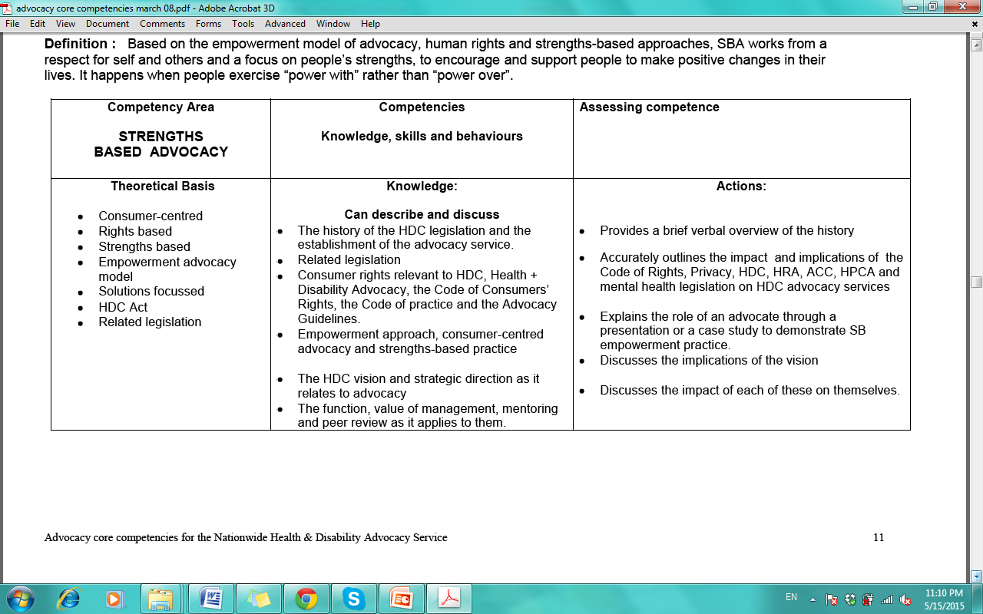

Slide 32
Type of advocacy activities
Lobbying
Public education/Campaign
Communication
Network formation / Networking
Capacity development
Leadership development

Slide 33
Determinants of health
Upstream (Macro-level) Factors | Midstream (Intermediate-level) Factors | Downstream (Micro-level) Factors
Social, Economic, Physical, Cultural and Environmental factors Early years, Education (including literacy), Food security, • Employment and working conditions, Income, Housing, Transport The social gradient, Social inclusion, Gender Beliefs and values systems, Health literacy Welfare support systems, Health Care systems, including access to health services | Psychosocial factors Control of one’s life Social supports Isolation and marginalisation Self esteem, Depression Stress, Aggression Behavioural factors Diet and nutrition, Smoking Alcohol, Physical activity Substance abuse (eg drugs, petrol sniffing), Self-harm Gambling, Safe sexual behaviours, Engagement in preventive health, care practices | Non-modifiable individual factors Age, Sex, Ethnicity, Genetics Physiological systems Endocrine (.eg. glucose intolerance), Immune systems (e.g. reduced immunity), Cardiovascular system (e.g hypertension, high lipids), Muscular-skeletal systems (e.g osteoporosis)
Upstream factors can impact on health in two ways: - Direct impact through factors relating to safety - Indirect impact by influencing health | Actions designed to change midstream determinants include individual lifestyle programs creation of supportive environments to make healthy choices easier. | Changes to physiological systems and biological functioning are brought about by sustained and longer term effects of psychosocial and behavioural factors.

