Slide 1
Health Education Specialists in Health Sector Evolution: A missed Role
Mohsen Shams, MD, PhD
Health Education Specialist
Yasuj University of Medical Sciences

Slide 2
Health Sector Evolution: the first phase and its main axes
Since 15/2/1393 (5th May 2014)
Reducing patient payment by admitted cases in MOHME hospitals
Supporting working physicians in deprived (less- developed) regions
Attending specialists in MOHME hospitals as residents
Improving the quality of visits in MOHME hospitals
Improving hoteling services in MOHME hospitals
Protecting financially the patients with hard to cure and special diseases and poor patients
Promoting normal vaginal delivery

Slide 3
According to Dr Rafieifar’s Presentation in the 1st day of congress
There are other phases for Health Sector Evolution
Enhancing PHC evolution in all rural regions and urban regions with population less than 20.000
Completing programs for marginal parts of the cities with 20.000-50.000 population and develop that for all cities with population less than 500.000
Evolution in family physician program in Mazandaran and Fars
Making operational the national self-care and empowerment programs
Enhancing and establishing inter-sectoral cooperation in county, provincial, national levels
Public Health Evolution in health system based on environmental health

Slide 4
Some general questions about the Health Sector Evolution?
Is it about “Health” or “treatment”?
Is it about “Health Sector” or “Health System”?
Is the “Financial Concerns” the most important issue and the first priority in Iranian health system? What are the evidences?
Is it limited to MOHME Hospitals and clinics ? What about and private, cooperative, and charity facilities?
What about the relationship between HSE and “family physician program”, “Referral system” and “PHC framework”? Which of them is the core and main component?

Slide 5
Professional questions about the Health Sector Evolution?
What was the role of HEP specialists in developing the program? Were they participated actively in or were innocent observers?
Are they involved enough in implementation of the program? (Training and empowering the healthcare providers)
Have they any proposals for evaluating the input, process, and output of the programs?

Slide 6
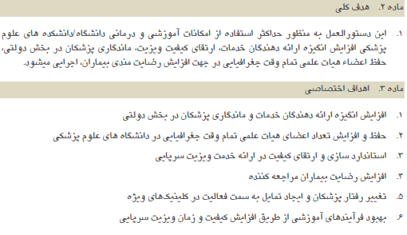
Improving the quality of visits in MOHME hospitals

Slide 7
Improving the quality of visits in MOHME hospitals

Slide 8
Responsibilities of Health Educators
Assessing needs of individuals, groups and communities
Designing effective health education programs
Participating in implementation of health education programs
Evaluating effectiveness of health education programs
Coordinating for developing educational services and products
Playing role as a reference person
Making a link between basic concepts and execution in healthcare system

Slide 9
Our main concerns
What does it mean:“Improving the quality of visits by physicians”?
Is it about Clinical Patient Education?
Is it about Health Education?
Are the physicians ready to educate their patients? Have they competencies for playing this role? Have been medical students trained to be an educator in clinical facilities? If yes, CONGRATULATION!!! But if not, what must we do?

Slide 10
Clinical Patient Education
A planned, systematic, sequential, and logical process of teaching and leaning provided to patients and clients in all clinical settings. It is also the continuous teaching and learning process involving the healthcare providers, patients or clients, and/or patient’s families.
Its goals are based on the patient’s assessment, evaluation, diagnosis, prognosis, and individual needs and requirements related to interventions.

Slide 11
Patient Health Education
It concentrates mostly on wellness, prevention, and health promotion. It can be provided to individuals, groups and communities for changing and improving health behaviors.
Self-Care
Self-Management
Self-Regulation
Self-Monitoring
Empowerment

Slide 15
Conclusion
Health sector Evolution is not a HEP-based programs yet!
HEP specialists must be more active for training the healthcare providers to be health educators!
By the way, IT IS NOT HEALTH SECTOR EVOLUTION yet!!!

Slide 16
Thank you for your attention!

