Slide 1
In the name of God
In the name of God

Slide 2
Title: Opportunities and Challenges of Qualitative Research in Health Education
Authors:
Dr. Fereshteh Zamani-Alavijeh,
Department of Health Education and Promotion, School of Health, Isfahan University of Medical Sciences

Slide 3
Objective
The purpose of this session is to provide an overview of
opportunities and Challenges of
qualitative research methods.

Slide 4
Opportunities of Qualitative Research in Health Education
Qualitative health research methods are often conducted because
some features of a phenomenon are poorly understood,
and the researcher wants to
extend a rich and comprehensive understanding of it.

Slide 5
Opportunities of Qualitative Research in Health Education
Qualitative research could help health educators
to improve their understanding the behaviors of
individuals and communities as well as factors and conditions that influence their health.

Slide 6
Rather than thinking of qualitative and quantitative strategies as incompatible, they should be seen as complementary
Opportunities of Qualitative Research in Health Education

Slide 7
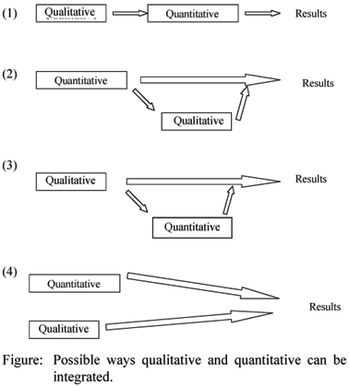
quantitative and qualitative research can be integrate at different stages of the research process.

Slide 8
DEDUCTIVE & INDUCTIVE REASONING

Slide 9
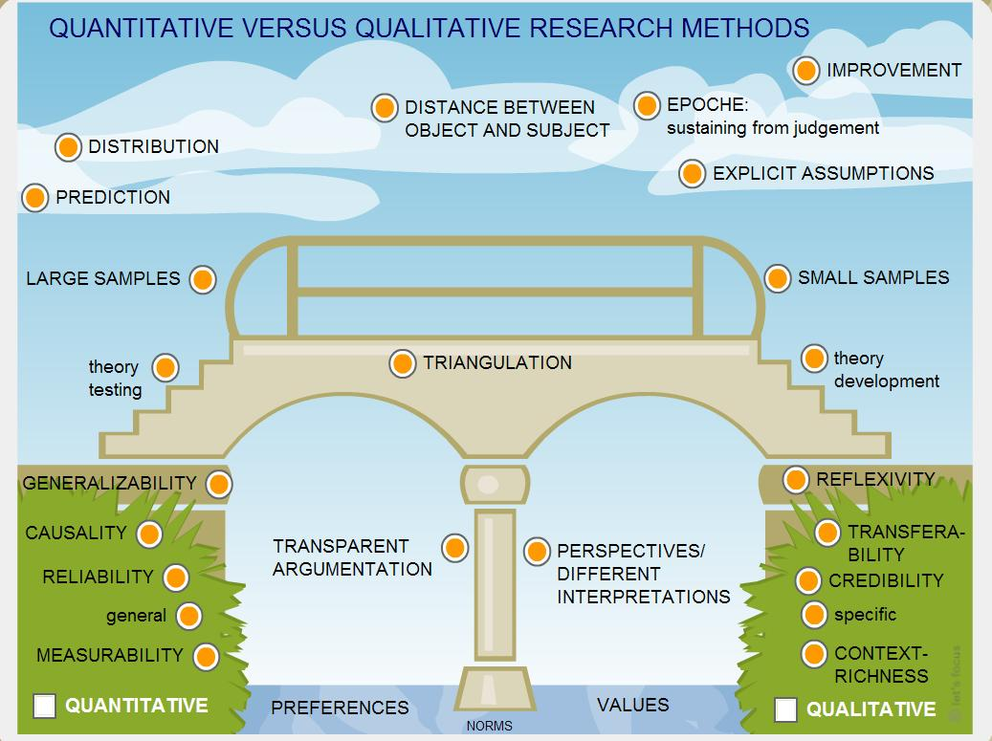
Notes:
http://www.google.com/imgres?imgurl=http://www.knowledge-communication.org/images/qual-vs-quant.jpg&imgrefurl=http://www.knowledge-communication.org/coursesandevents.html&h=775&w=1037&tbnid=_4h958dq6ZWtkM:&zoom=1&docid=HozxIw0ULX_OxM&ei=6OZcVcL8G6HmywPImoGoBw&tbm=isch&ved=0CCoQMygFMAU/ www.knowledge-communication.org1037 × 775Search by image

Slide 10
Opportunities of Qualitative Research in Health Education
opportunities
Quantitative researchers usually know exactly what kind of knowledge they expect to get by doing a study, and then try to obtain it.
?
By contrast, sometimes:
researchers enter the study that does not know what it is about the subject.
?
?

Slide 11
Opportunities of Qualitative Research in Health Education
When the researchers
know what they do not know,
Quantitative study is appropriate.
?
By contrast, sometimes,
that is not knowing what is not known,
the qualitative methods can be useful to conducting research (Polit and Beck, 2006).
?
?

Slide 12
Opportunities of Qualitative Research in Health Education
A quantitative research,
with deductive approach,
begins with limited frame and certain theory,
and tests it
by try to detect evidence to confirm or reject a specified hypothesis.
The qualitative studies provide opportunities to explore what is important about the phenomenon of interest.

Slide 13
Opportunities of Qualitative Research in Health Education
Qualitative researches, with inductive approach,
provide opportunities to develop understanding of health behavior
and generate a new theory by data extracted from the community.
Applying this theory will increase opportunities for identifying behaviors and related factors (such as predisposing, reinforcing and enabling) to improve the health of individuals and groups in that community.

Slide 14
DEDUCTIVE Approach
Quantitative research methods are used when you often have a theory to test .
HBM
?
SE
TPB
HPM
The rest of the factors will be ignored.
X
community
SR
TTM
H_{1:}
H_{0:}

Slide 15
INDUCTIVE Approach
HBM
?
SE
TPB
HPM
community
X
SR
TTM

Slide 17
Challenges of Qualitative Research in Health Education
Health education researchers face several challenges in conducting qualitative study because
the strengths, objectives and processes of qualitative methods are unfamiliar to many.
In contrast, the strengths, purposes and processes of quantitative methods are well familiar and accepted.

Slide 18
Challenges of Qualitative Research in Health Education
→→Some researchers, therefore, refer to quantitative methods as “the dominant paradigm”.
However, some health research questions are better suited for research using qualitative methods.

Slide 19
Special challenges of preparing proposals for qualitative research
→→ The main issue is that the standard demands of a proposal put researchers into a paradoxical situation
“Researchers have intentionally selected a qualitative method because little is known about the area—yet how can they write about,
for example, how they are going to analyze data, when the nature of the data are not known?” (Morse (1995)

Slide 20
Special challenges of preparing proposals for qualitative research (continue)
Decisions for qualitative studies evolve in the field, and therefore it is seldom possible to provide detailed or in-depth information about such matters as sample size, data collection strategies, data analysis, and so on.
Even literature reviews for qualitative proposals are typically lean because there is not much prior research about the phenomenon of interest.

Slide 21
Qualitative researchers, therefore, must persuade reviewers that
the topic is important
and worth studying,
that they are sufficiently knowledgeable about the challenges of field work and
adequately skillful in eliciting rich data,
and,
the project would be a very good risk.

Slide 22
Researchers that poorly defined qualitative jargon used in a proposal is especially susceptible to criticism.
Morse and Richards (2002) stress that there must be methodological congruence throughout a qualitative proposal.

Slide 23
Challenges of Qualitative Research in Health Education
In qualitative studies, researchers face numerous conceptual, theoretical, practical, ethical, and methodologic challenges.
The major challenge is designing studies that are trustworthy.

Slide 24
planning a qualitative study

Slide 25
What we need to know to develop this plan:
What is qualitative research?
What types of problems are best suited for qualitative research?
How to write a qualitative purpose statement and research questions
What tradition or type of qualitative research best fits our research problem?
What types of qualitative data we should collect?
Identifying our process for analyzing the data
Assessing our packages that will help with data analysis

Slide 26
What do we need to keep in mind when designing a qualitative study?
Focus on process as well as outcomes
Use inductive reasoning
Follow the “scientific method”

Slide 27
Start with a research topic and a research problem
Specify the research problem: (write the issues that leads to a need for your study. )

Slide 28
Stay away from quantitative language for a good qualitative purpose statement
What is not included in this statement:
Not a comparison
Not relating variables
Not proving hypotheses
Not measuring variables

Slide 29
Writing good qualitative research questions (Limited number )
Two types questions:
Central question
is the most general question
Sub questions
Sub-divides central question into more specific topics questions

Slide 30
Design the methods for qualitative study.
What to include:
Data collection or generation
Data analysis
Data representation
Data interpretation
Data validation
The type of qualitative “tradition” we will use in our methods
For example
Phenomenology, Ethnography, Grounded Theory, Action Research,…

Slide 31
Each qualitative proposal must reflect in a systematic fashion the assumptions, questions, data collection strategies, and analytic methods of the chosen tradition.
Tell why we chose it and how it relates to the study’s purpose.

Slide 32
The Qualitative Traditions
Dimension | Phenomenology | Grounded Theory | Ethnography
Focus | • Understanding the essence of experiences about a phenomenon | • Developing a theory grounded from data in the field | • Describing and interpreting a cultural or social group
Data Collection | • Long interviews with up to 10 people | • Interviews with 20-30 individuals to “saturate” categories and detail a theory | • Primarily observations and interviews with additional artifacts during extended time in the field (e.g. 6 months to a year)
Data Analysis | • Statements • Meanings • Meaning themes • General description of the experience | • Open coding • Axial Coding • Selective Coding • Conditional Matrix | • Description • Analysis • Interpretation

Slide 33
What types of information can be collected in qualitative research?
Who will be studied?
What information will be collected?
Interviews
Observations
Documents
Audio-Visual Materials

Slide 34
Practical Challenges Using Qualitative
The practical challenges of an interview depend on the ability of the researcher to create an appropriate atmosphere.
This has to do both with the place and the spirit.

Slide 35
Practical Challenges Using Qualitative
The practical challenge is to create proper contacts with the informants, to make them feel secure, to motivate them to talk about their experiences, feelings, to tell their stories
Language can be a barrier in the communication between the researcher and the participants.
Even in absence of language barriers, different social groups maybe use different words to express their feelings.

Slide 36
A practical challenge is to choose the right way to store the information:
write the answers, save them on audio-tape, or even use video equipment.
we have to choose the best way to store the information, taking into consideration the informants specifications .

Slide 37
Methodological challenges:
Will the methods used to address the research question yield accurate and valid results?

Slide 38
Transcribe the interview
Fracturing Data (Glaser,1978; Tesch,1991; Strauss & Corbin, 1990;1998):
P₁
………………….
……..
….. …- .
….. …- .
line by line
……….
-------
….. …- .
… …….. ..
….. …- .
….. …- .
…… .
--……,…
….-..
….. …- .
……,….
…….,….. .
….. …- .
& Coding
….. …- .
….. …- .
….. …- .
P₂
………………….
……..
….. …- .
….. …- .
……….
-------
….. …- .
… …….. ..
….. …- .
….. …- .
…… .
--……,…
….. …- .
….-..
……,….
….. …- .
…….,….. .
….. …- .
….. …- .
….. …- .

Slide 39
Substantive coding
Continuous with previous phase
Theoretical
….. …- .
….. …- .
Reduction
….. …- .
….. …- .
….. …- .
….. …- .
….. …- .
….. …- .
….. …- .
….. …- .
….. …- .
….. …- .
….. …- .
….. …- .
Then we engage in the coding process that involves several steps:
….. …- .
….. …- .
Theory
….. …- .
….. …- .
….. …- .
….. …- .
….. …- .
….. …- .
….. …- .
….. …- .
….. …- .
….. …- .
….. …- .
….. …- .
….. …- .
….. …- .
….. …- .
….. …- .
….. …- .
….. …- .
….. …- .
….. …- .
….. …- .

Slide 40
In this analysis process, maybe we use a computer program to help? Some computer programs available: Maxqda http://www.maxqda.com Atlas.ti http://www.atlasti.de/index.html N6 http://www.qsrinternational.com/ NVivo http://www.qsrinternational.com/

Slide 41
It is wise to remember, too, that the aim is
not to discover the theory, but a theory(37).

Slide 42
Analyzing Data Toward Grounded Theories
Putting Pieces of a Puzzle Together(37)

Slide 43
Helen Heath*, Sarah Cowley, International Journal of NURSING STUDIES, 41 (2004) 141–150
www.sciencedirect.com
data
data
data
data
Theory
Induction
emerging
questions
and pattern
Deduction/ Verification
data
data
data
data

Slide 44
Induction Approach استقرايي
[General research question]
Observation
Theory Formulation
Notes:
Inductive theory starts with a vague concept then uses specific forms of observations of empirical evidence, on the basis of this, you generalise and build theories.

Slide 45
challenges of qualitative analysis
Qualitative data analysis is a particularly challenging enterprise, for three major reasons.
1-there are no universal rules for analyzing and presenting qualitative data. The absence of standard analytic procedures makes it difficult to explain how to do such analyses, how to present findings in such a way that their validity is apparent, and how to replicate studies.

Slide 46
The Assessment Of Qual. & Quan. Data
(Polit 2006):
Credibility
Confirm ability
Dependability
Transferability
Trustworthiness
(Lincoln & Guba, 1985)
Face Validity
Content Validity
Validity & Reliability
Cronbach's Alpha
Choderichardson

Slide 47
Credibility
Prolong Engagement
Circular Data Collection & Analysis
Triangulation View ( Method, data, source, time)
Peer Debriefing & Member Check
Constant Comparison Analysis
Search For Disconfirming Evidence (Negative Case Analysis)

Slide 48
2. The second challenge of qualitative analysis is the enormous amount of work required. Qualitative analysts must organize and make sense of pages and pages of narrative materials.

Slide 49
3.The final challenge comes in reducing data for reporting purposes. Quantitative results can often be summarized in two or three tables. Qualitative researchers, by contrast, must balance the need to be concise with the need to maintain the richness and evidentiary value of their data.

Slide 50
با تشكر
خسته نباشيد

Slide 51
برای قابل تصديق و تأیید بودن داده ها Confirm ability
افکارو پیش فرض های ذهنی محقق کنار گذاشته می شود (Bracketing )
داده ها مرتب با Participant چک می شود (Member Check).
جریان کدگذاری و آنالیز داده ها توسط ناظرین بازبینی و اصلاح می شود Peer Debriefing

Slide 52
Dependability
برای قابليت اطمينان،اعتماد و وابستگی از روشهای زیر استفاده می شود:
داده های اصلی برای بررسی مجدد دردسترس نگه داشته می شود. Original Data Availability
یافته ها مبتنی بر شواهد و Evidence base خواهد بود.
مراحل بصورت گام به گام انعکاس می یابدStepwise replication
چالش هایی را که ناظران و همکاران مطرح می کنند مورد رسیدگی و انعکاس خواهد یافت. External Reviewer & Debriefing

Slide 53
Transferability
برای قابليت انتقال يا تعميم پذیری نتايج
یافته ها با گزارش مطالعات دیگر مقایسه خواهد شد External report Check
نمونه گیری به روش تئوریک با حداکثر تنوع انجام خواهد شد Maximum variance of sampling

Slide 54
In the name of God
In the name of God

Slide 55
84-Polit DF, Beck CT. Essentials of Nursing Research: Methods. Appraisal. and
Utilization. Lippincott Williams & Wilkins. Philadelphia. PA. USA. 8th ed. 2006.

