Slide 1

Title:
Effects of an osteoporosis prevention training program on physical activity-related stages of change and self-efficacy among university students, Shiraz, Iran: a randomized clinical trial
MOHAMMAD HOSSIEN KAVEH
and Co-researchers

Slide 2
Mohammad Hossien Kaveh ,
Monire Golij ,
Mahin Nazari ,
Zohreh Mazloom , and
Abbas Rezaeian Zadeh

Slide 3
Introduction
Osteoporosis is a major problem in today's world.
In the Americas and Europe,
  osteoporotic fractures account for 2.8 million disability-adjusted life years (DALYs) annually, and
in Iran it is over 36761 years.

Slide 4
Promoting physical activity, as an important preventive strategy.
But how?
By which methods?
  Education (empowerment)!
  Environmental support!
Which factors should be taken into account?
Notes:
Optimal effectiveness and sustainability of health promotion programs depend on application of such principles as target populations’ participation, and voluntary adoption and application of the changes.
Empowerment is one of these principles. It refers to increasing people’s control over decisions, lifestyle and activities that affect their health. This approach tries to develop self-esteem, self-management and self-control and make changes in behavior. Empowering has an important role in encouraging people to change their lifestyle.

Slide 5
Knowledge-Practice gap!
  There was a few similar studies!
  Focusing on factual information!
  Biomedical (behavior-change) approach!
  Are interventions tailored to the needs/conditions of audiences?
  …

Slide 6
The study purpose:
  To assess the effects of an osteoporosis prevention training program on physical activity-related stages of change and self-efficacy among university students

Slide 7
Methods:
  Educational randomized control trial
  Study population: female students in Shiraz University of Medical Sciences
  Sample: 152 (76 in experimental and 76 in control groups.
  Sampling: stratified- cluster sampling method.

Slide 8
Intervention:
  four 120-minute training sessions, using interactive teaching-learning methods such as problem-based learning (PBL) and small group techniques
  in addition video clips, brochures and SMS contacts were used.

Slide 9
Measurements:
  Pretest
  2 posttests:
    One week
    Six week after intervention
  Tools:
    Stages of Exercise Change Questionnaire, created by Marcus and colleagues(Kappa coefficient: .78)
    A researcher-made self-efficacy questionnaire (alpha: .88)

Slide 10
Ethical consideration:
  Informed consents
  The research project was approved by the research council as well as ethics committee of shiraz University of medical Sciences

Slide 11
findings

Slide 12
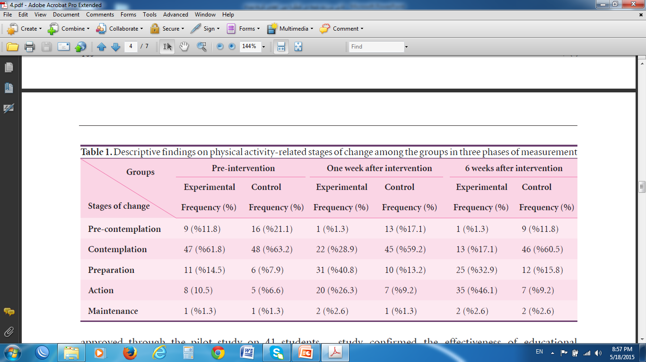

Slide 13
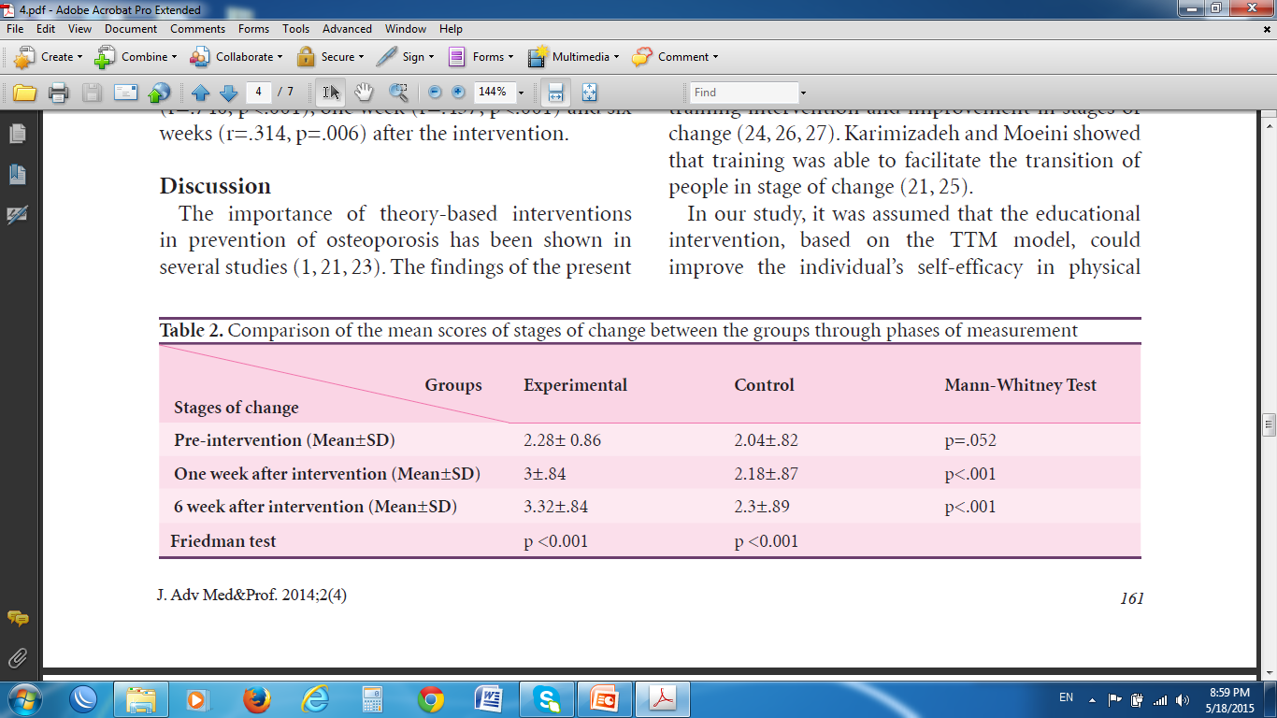

Slide 14
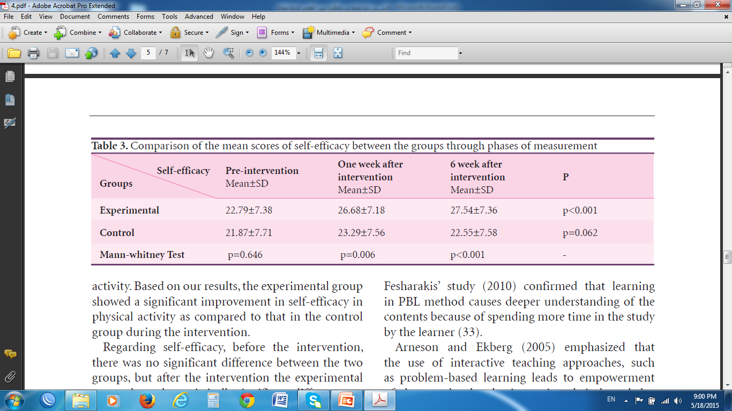

Slide 15
Discussion

Slide 16
Changes imply that planned educational program is an important mechanism for behavior change
  Karimzadeh (2007),
  Annesi (2010),
  Moeini (2010)
  Sharifirad (2009)

Slide 17
The Study limitation:
Using self-report as a way of gathering data
This study was carried out in shiraz UMS
This study had no long-term follow-up

Slide 18
Conclusion:
  According to the results of the present study, developing and implementing educational interventions based on using interactive teaching methods and appropriate patterns should be considered for adolescents and young adults.
  Also, further trials using various methods and theories are recommended.

Slide 19
Thank you for your attention

