Slide 1
Nutritional Knowledge and Public Health in Kermanshah; From Sciences to Practice
Dr. Yahya Pasdar
PhD in Nutrition
Kermanshah University of Medical Sciences

Slide 2
Out Lines:
Iron Deficiency and Anemia in Girls Students of KUMS
Anemia among Labour Children in Kermanshah
Malnutrition and Educational Achievement in School Children
Salt Fortification with Iodine in Kermanshah: Truth OR False
Dietary Pattern among Households of Kermanshah
Effect of Governmental Food Subsidies Removal on Public Healt

Slide 3
Material and methods:
All studies have been well designed by our research team.
All studies have been approved by KUMS research committee.
Ethical approval obtained if necessary.
All studies included enough sample size.

Slide 4
I
Iron deficiency and anemia in girls students of KUMS

Slide 5
Dietary pattern of food consumption compare to RDA in KUMS students

Slide 6
Iron deficiency and anemia among the KUMS girls students

Slide 7
Study also showed that:
More than 26% of students suffered from depression

Slide 8
II
Anemia among labour children in Kermanshah

Slide 9
Starting age of work in labour children

Slide 10
Anthropometric indices in Working and Non-working Children
P | Mean±S.D |  | Anthropometric Parameters
 | Non-working children | Working children
0.02 | 62.1 ±13 | 56.4±1.2 | Weight (kg)
0.3 | 170.6±7.6 | 166.9±10.7 | Height (cm)
0.01 | 21.25±3.8 | 20.09±3.2 | BMI(Kg/m²)

Slide 11
Food consumption in Working and Non-working Children
P | Non-working children |  | Working children |  | Food Consumption
 | No (%) | Yes (%) | No (%) | Yes (%)
0.001 | 14.4 | 85.6 | 44.4 | 55.6 | Breakfast
0.001 | 6.2 | 93.8 | 27.2 | 72.8 | Lunch
0.1 | 11.6 | 88.4 | 18.5 | 81.5 | Dinner

Slide 12
Blood biomarkers of the working and non-working children
 | Mean±S.D |  | Blood Biomarkers
P | Non-Working children | Working children
0.01 | 72.3±56.1 | 71.2±34.8 | Ferritin (mg/ml)
0.05 | 6.6±1.5 | 6.5±1.4 | WBC (× 10³/µl)
0.05 | 5.3±0.4 | 5.2±0.3 | RBC (× 10⁶/µl)
0.05 | 267.4±4.6 | 269.7±50.9 | PLT(× 10³/µl)
0.05 | 67.7±49.2 | 82.5±5.6 | MCV (fL)
0.05 | 15.2±1.5 | 14.6±1.2 | HGB (g/dl)
0.05 | 25.2±13.8 | 27.9±2.3 | MCH (Pg)
0.05 | 44.2±3.6 | 43.2±3 | HCT (%)
>0.05 | 32.1±12.6 | 33.9±1 | MCHC (g/dl)
>0.05 | 31.2±0.9 | 13.7±1.1 | RWD-CV(%)

Slide 13
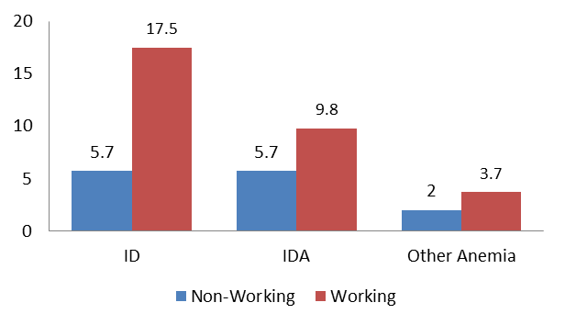
Prevalence of anemia in children
*P= 0.04
*P= 0.001

Slide 14
III
Educational achievement relationship with nutritional status in primary school children in Kermanshah (2012)

Slide 15
Malnutrition based on WHO classification in children

Slide 17
Relationship between educational achievement and growth factors
BMI |  | Height |  | Weight |  | Courses
r | P value | r | P value | r | P value
0.014 | 0.83 | 0.191- | 0.018 | 0.182- | 0.02 | Mathematic
0.112 | 0.01 | 0.10- | 0.02 | 0.09- | 0.04 | Writing skills
0.080 | 0.09 | 0.019- | 0.68 | 0.052- | 0.28 | Memorising
0.09 | 0.05 | 0.039- | 0.41 | 0.044- | 0.36 | Religious
0.019 | 0.69 | 0.113 | 0.01 | 0.037- | 0.44 | Reading
0.065 | 0.17 | 0.017 | 0.723 | 0.035 | 0.46 | Sciences

Slide 18
Relationship between food consumption and educational achievements
Foods | Milk | Red meat | Poultry | Diary | Rice | Salad | Nuts | Lentil
* r | 0.229 | 0.127 | 0.128 | 0.119 | 0.136 | 0.098 | 0.126 | -0.121
P | 0.001 | 0.001 | 0.007 | 0.01 | 0.004 | 0.007 | 0.007 | 0.01

Slide 19
IV
Iodine salt fortification in Kermanshah: Truth OR Untruth

Slide 20
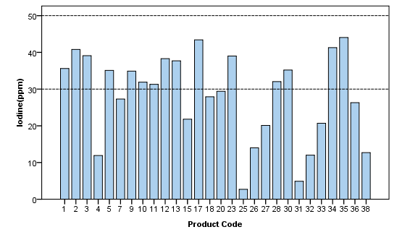
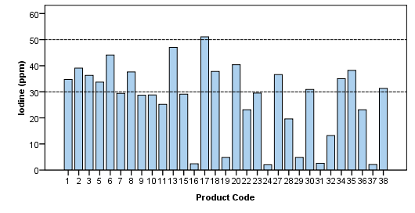
Iodine contents of fortified salt
One moth after production date
One year after production date

Slide 21
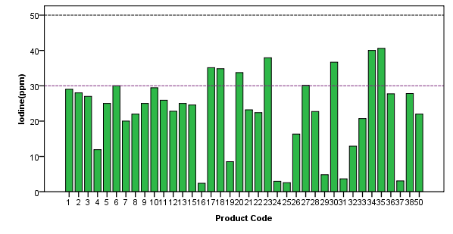
Average iodine content compare to standard level in distributed salts

Slide 22
Iodine content of fortified salt distributed in Kermanshah

Slide 23
V
Dietary Pattern of Households in Kermanshah

Slide 24
Food groups consumption compare to recommendations

Slide 25
Percent of Oils consumption in 6 Zones
of Kermanshah

Slide 26
VI
Dietary patterns changes after removal of foods subsidy in Kermanshah

Slide 27
Consumption of food groups before and after governmental subsidy removal
P-value | Survey 2012 | Survey 2010 | Food Groups
0.001 | 4.1±1.2 | 6.6±2.4 | Bread
0.01 | 1.03±1.4 | 1.9±1.2 | Dairy
0.01 | 1.1±0.5 | 1.2±0.1 | Meat
0.001 | 1.4±0.8 | 2±0.1 | Vegetable
0.001 | 2±1.2 | 3.3±0.1 | Fruit
cv
cv

Slide 28
Diary products consumption before and after subsidy removal

Slide 29
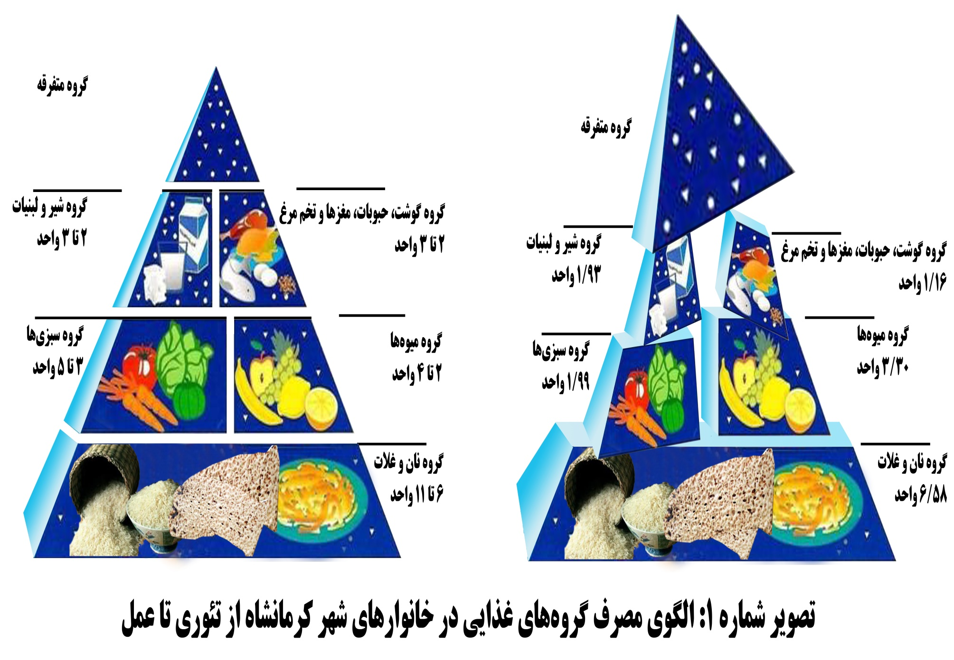

Slide 30
Conclusion: I
Iron deficiency and anemia is more prevalent among children and students. Nutritional education and support is necessary to improve public health.

Slide 31
Conclusion: II
Well nourishment of children may help better educational achievement and better future of next generation

Slide 32
Conclusion: III
Government close attention and support is required for food quality control and low-income families.
Milk subsidy is necessary for children who are living in deprived areas for optimum growth.

Slide 33
Conclusion: IV
Academic collaboration between health education and nutritionist
may lead to develop more effective strategies to improve public nutritional knowledge.
We need to make a bridge to achieve
well nutrition and health promotion

Slide 34
Thanks:
Our Research team:
Dr. Mansour Rezaie
Dr. Behrooz Hamzeh
Dr. Mostafa Nachvak
Dr. Farid Najafi
Ms. Mitra Darbandi Ms. Parisa Niazi
Ms. Shekofe Alghasi
Ms. Neda Izadi

