Slide 1
Factors associated with home-related injuries among children under 5 years, using PRECED model, in rural areas of Toyserkan in 2012
Forouzan Rezapur-Shahkolai
Assistant professor of Health Promotion with speciality in Safety Promotion and Injury Prevention
Department of Public Health, School of Public Health & Research Center for Health Sciences
Hamadan University of Medical Sciences
Hamadan
Iran

Slide 2
Introduction:
Injuries are one of the major causes of death and disability among children in the world and especially in the low and middle-income countries.
Prevention of them is an important public health priority that needs comprehensive interventional approaches, including educational strategies.
This study aimed to access factors associated with home-related injuries among children under 5 years of rural areas of Toyserkan, using PRECED model.

Slide 3
Methods:
This cross-sectional study has been conducted in rural areas of Toyserkan County, during December 2012 through January 2013.
The registered data of all home-related injuries which occurred among under-five children, between 21 March 2011 and 20 March 2012.
Data were obtained from Toyserkan district health center.

Slide 4
Methods:…
Victims were identified at the village level and then the details about injury characteristics, injured children, and their mothers' beliefs and behaviours regarding child-injury prevention.
Based on PRECED model, focusing on predisposing factors, enabling factors, reinforcing factors and preventive behaviors with home- related injuries.
The interviews were done with the mothers of injured children by trained interviewers, using questionnaire. To analysis the data, the SPSS,16 was used.

Slide 5
Results:
The rate of reported home- related injuries among children under five years, in rural areas of Toyserkan, was 100 per 1000 person-years.
Most of injured children were in age between 36 and 47 months (30%). Most of injury mechanisms were falls and burns (35% and 31.5%, respectively).

Slide 6
Results:…
No injury death was reported among study population. Injury rate was higher in boys than girls (56% vs. 44%).
Hand was the most common injured body region (33/5%).
The most injuries were in the summer and the first aids for injured people were related to domestic actions (43%).
Complete recovery was the most frequent result of injuries (81%)

Slide 7
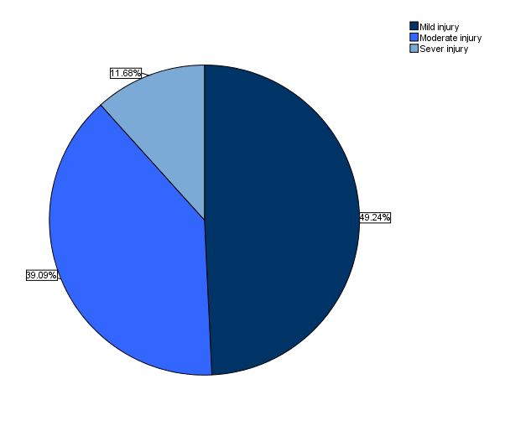
Results:…
Regarding injury severity, majority of injuries were mild injuries (49%).

Slide 8
Results:…
Regarding PRECED model, there were significant relationship between predisposing factors (knowledge and attitudes), reinforcing factors, preventive behaviors of mothers and the occurred home-related injuries among <5 year old children (p<0.05).
But, there was no significant relationship between enabling factors and injury mechanisms among <5 year old children.

Slide 9
Results:…
Relationship between PRECED model constructs among mothers and the occurred home-related injury mechanisms among <5 year old children (n=197) ((ANOVA
P- value | f | Mean squares | df | Sum of square | Constructs
0.005 | 2.83 | 7.07 | 8 | 56.61 | Predisposing Factor (Knowledge)
0.020 | 2.34 | 52.37 | 8 | 419.01 | Predisposing Factor (Attitude)
0.022 | 0.24 | 0.21 | 8 | 1.72 | Reinforcing factors
0.982 | 2.30 | 1.53 | 8 | 12.24 | Enabling factors
0.046 | 2.01 | 15.62 | 8 | 125.01 | Preventive behaviors & measures

Slide 10
Conclusion:
Home-related injuries are important health problem in rural areas of Toyserkan and their prediction and prevention are necessary.
The PRECED model can be helpful to determine the predicting factors of home-related injuries among children under 5 years.

Slide 11
Conclusion:…
Therefore the improvement of knowledge, attitudes and behaviors of rural mothers through planning the education program can be helpful .
Using the model applied in the current study for the planning an educational intervention, may be effective on injury prevention and safety promotion among children under five years.

Slide 12
Thank you for your attention!

