Slide 1
Definition and Application of Q-methodology in Health Care
Bijan Kaboudi; M.D.
Kermanshah University of Medical Sciences
مطلب تویی،
طالب تویی،
هم مبتدا،
هم منتها...

Slide 2
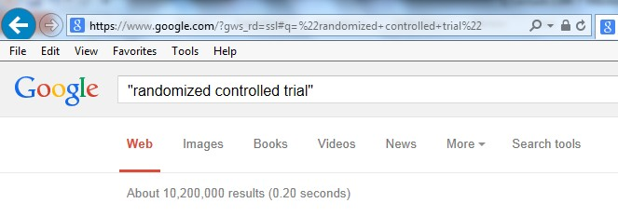

Slide 3
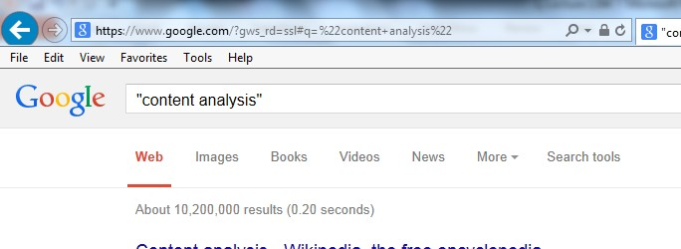
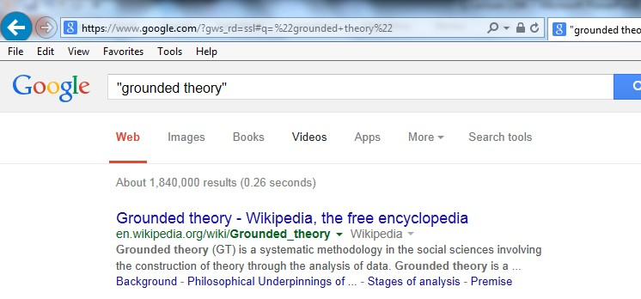

Slide 4
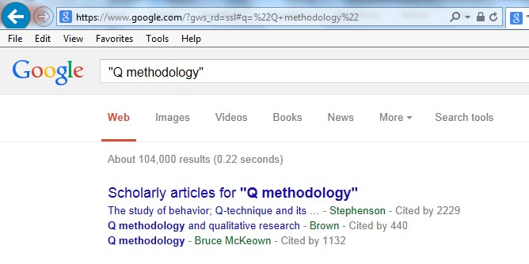

Slide 5
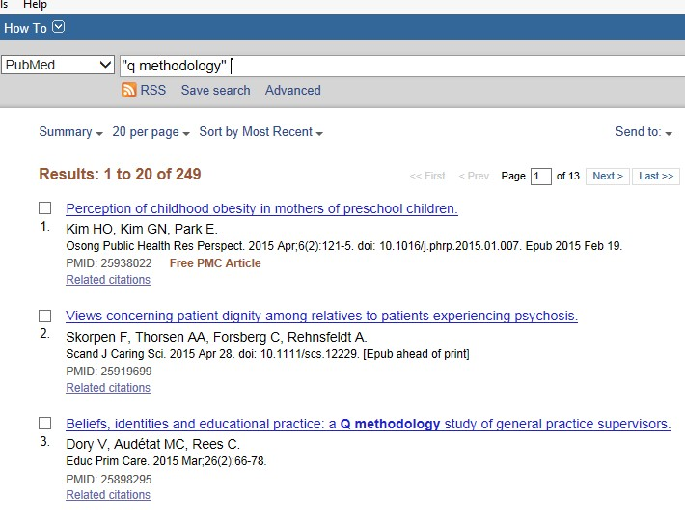

Slide 6
نقش كانونهاي تفكر داراي مجوز از وزارت علوم، تحقيقات و فناوري در خط مشي هاي عمومي: پژوهشي بر مبناي روش كيو (Q)
شناسايي و دسته بندي چالش ها و موانع تجاري سازي دانش با استفاده از روش كيو
شناسايي ذهنيت افراد نسبت به سياست هاي خصوصي سازي در ايران (سياست هاي اصل 44 قانون اساسي)
شناسايي الگوهاي ذهني اساتيد الكترونيكي دانشگاه تهران در نقش ياد دهنده: پژوهشي بر مبناي روش كيو
شناسايي موانع رفتاري كارآفريني سازماني در سازمان هواپيمايي جمهوري اسلامي ايران بر مبناي روش شناسي كيو
نگرش سنجي رابطه دولت و ملت در ايران (روش شناسي كيو)
شناسایی دیدگاه های حا کم بر آسیب پذیری شهرها در برابر مخاطرات محیطی و استخراج مؤلفه های تأثیرگذار در آن
کاربردهای کامپیوتردر شهرداری تهران:شناسایی کاربرد کامپیوتر کارمندان حوزه فنی و عمرانی با استفاده از روش شناسی کیو
شناسایی ذهنیت دانشجویان در زمینه چالش‌های انجام پژوهش در یادگیری الکترونیکی و موسسات مجازی " به روش کیو"
روش کیو و کاربرد آن در یک مطالعه موردی: گونه شناسی ذهنیت نخبگان در مورد راه های مدیریت دولت افقی در ایران
بررسی و مقایسه تاثیر روشهای مشاور محوری و مراجع محوری بر خویشتن‌پنداری مراجعان با بهره‌گیری از تکنیک اندازه‌گیری کیو
بررسی جامعه‌شناختی الگوهای موفقیت و عوامل مؤثر بر آن

Slide 7
Overview
Background Knowledge
History of Q Methodology
Correlation
Factor Analysis
Q-Factor Analysis
Research Question
Sample Selection
Concourse Selection
Sort Procedure
Analysis
Interpretation

Slide 8
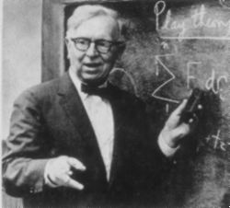
Background Knowledge
History of Q
Founded in 1935 by British physicist-psychologist William Stephenson who studied under Spearman

Slide 9
What is Q Methodology (Q)?
Measure of Subjectivity
Used in Psychology, Marketing / Advertising, Political
Based on correlation between item sorts (people, views)

Slide 10
What is Q Methodology?
Q is both a quantitative and qualitative technique which is used to study subjective experience
It has been widely used to study subjective and debatable issues.
It has been used particularly successfully in health related research.
Notes:
Philosophical positions
Positivism - unproblematic relationships between our
perception of the world and the world itself. The goal
is to provide objective knowledge of the world.
Social Constructionism
People constructs their social realities
All experience is situated socio-culturally and
historically

Slide 11
Q: Theory & Practice
Q involves sorting a set of statements to represent a perspective or viewpoint (the process of making subjectivity operant)
Focuses on viewpoints shared by particular groups of participants
By-person factor analysis identifies groups of Q sorts that have been completed in a similar way and can be clearly distinguished from other groups that emerge
Factors called perspectives or narratives

Slide 12
Q: Practicalities
Q involves 4 main stages:
Development of the Q pack (materials)
Q sorting (participants)
Statistical analysis
Factor interpretation

Slide 13
Developing the Q pack
Statements Piloted for:
Balance
Clarity
Coverage

Slide 14
Background Knowledge
Correlation
A measure of the relationship between two or more variables.
Correlation coefficient range: - 1 to +1

Slide 15
Background Knowledge
Factor Analysis
Purposes: - Reduce the number of variables - Identify structure in the relationships between variables
Based on correlation between items
Data reduction technique; can be used in factor regression
Number of Factors determined by cutoff (e.g. eigenvalue > minimum value)
Factor Loading – correlation between variable and factor

Slide 16
Background Knowledge
Factor Analysis-Extraction Methods
Process of determining factors
Principle Components Method
most common method
first factor accounts for most variance, next factor is orthogonal (accounts for most remaining variance)
Centroid Method – Used in Q

Slide 17
Background Knowledge
Factor Analysis – Rotation
Facilitates interpretability
Orthogonal (factors are uncorrelated)
Varimax
Oblique
Judgmental
Graphical

Slide 18
Background Knowledge
Factor Analysis
 | Age | Car | Education | Hobbies | Income
Bill | 47 | Lincoln | BS | Yachting | $50,000
Jane | 28 | Jaguar | PhD | Travel | $30,000
Luke | 43 | Honda | BS | Flying Planes | $45,000
Mary | 52 | Chevy | BA | Antiquing | $45,000
Steve | 34 | Jaguar | PhD | Extreme Sports | $35,000

Slide 19
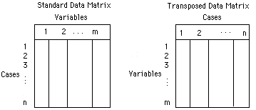
Background Knowledge
Q-Factor Analysis
Based on correlation between people (not items)
Computing factors that maximize variance (varimax)
Problems: correlations between dissimilar items (interpretation)

Slide 20
Background Knowledge
Q-Factor Analysis
 | Bill | Jane | Luke | Mary | Steve
Age | 47 | 28 | 43 | 52 | 34
Car | Lincoln | Jaguar | Lincoln | Chevy | Jaguar
Education | BS | PhD | BS | BA | PhD
Hobbies | Yachting | Travel | Flying Planes | Antiquing | Extreme Sports
Income | $50,000 | $30,000 | $45,000 | $45,000 | $35,000

Slide 21
Sample Selection
Small Samples (n < 100)
People of representative group defined by research question
Example: students who did not return to institution; students who graduated

Slide 22
Concourse Selection
Concourse = items to be sorted
Items must be clear and understandable by subjects
Text, graphics, audio, visual (e.g. advertising)
Should be representative of major views
Can have positive or negative voice
Concourse ideally developed by consensus of “experts”

Slide 23
Concourse Selection
Example – Sample Statements
“I had adequate time to complete lab exercises.”
“My instructor used teaching methods well suited to the course.”
“My instructor organized this course well.”
“My lab instructor was available during office hours.”
“Course assignments were interesting and stimulating.”
“Course assignments helped in learning the subject matter.”
“My lab instructor provided sufficient help in the lab.”
“My instructor was well prepared for class meetings.”
“The objectives for the lab activities were well defined.”
“I kept up with the studying and work for this course.”
…

Slide 24
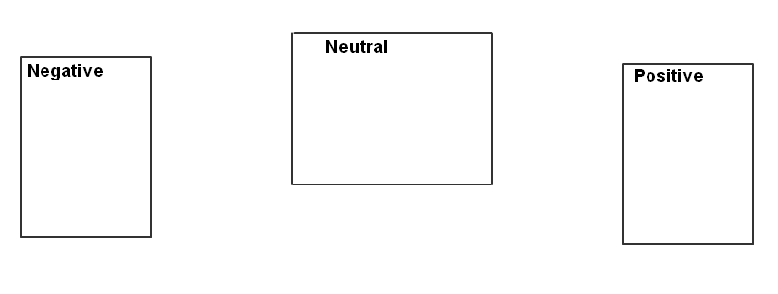
Sort Procedure
Intermediate Piles (usually 3-5) to simplify process for subject
Optional accompaniment by researcher; interactive questioning, note-taking. Provides qualitative data to enhance quantitative findings

Slide 25
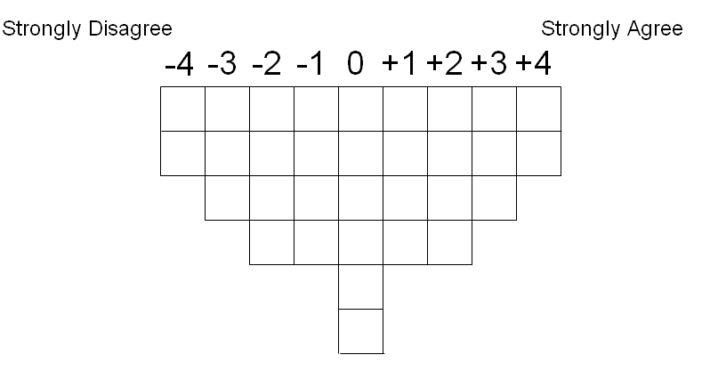
Sort Procedure
Scale

Slide 26
Sort Procedure
Scale
Bi-polar
e.g. Very Much Disagree to Very Much Agree
not
Least Important to Most Important

Slide 27
Analysis
Software:
PQMethod (free download; DOS program)
PCQ
SPSS / SAS (Factor Analysis)
Factor Analysis
Factoring of correlations between sorts
Rotation of Factors (Graphical), Minimize mixed loadings

Slide 28
Results
Factors consisting of people sharing similar views
Example
Factors
1 2 3
QSORT
1 0.0524 0.0719 0.5113X
2 0.4026X -0.0551 0.0752
3 -0.1286 0.9247X 0.3582
4 -0.0720 0.1966 0.5738X
5 0.0151 0.1267 0.6273X
6 0.1692 0.0241 0.5749X
7 0.1692 0.0129 0.5076X
8 0.7569X 0.0838 0.4651
9 0.0832 0.0137 0.2976

Slide 29
Results
Factors consisting of people sharing similar views
Example
Factors
1 2 3
QSORT
1 0.0524 0.0719 0.5113X
2 0.4026X -0.0551 0.0752
3 -0.1286 0.9247X 0.3582
4 -0.0720 0.1966 0.5738X
5 0.0151 0.1267 0.6273X
6 0.1692 0.0241 0.5749X
7 0.1692 0.0129 0.5076X
8 0.7569X 0.0838 0.4651
9 0.0832 0.0137 0.2976

Slide 30
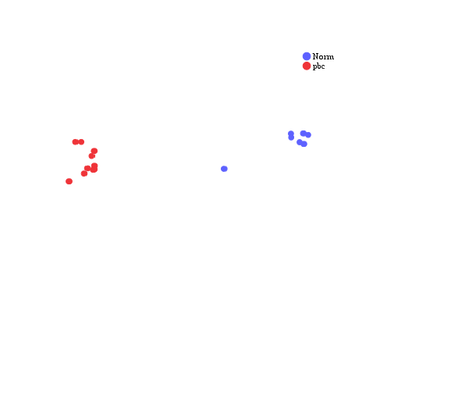
F1
F2

Slide 31
F1
F2

Slide 32
F1
F2

Slide 33
F1
F2

Slide 34
F1
F2

Slide 35
F1
فاکتور دو
Rotation

Slide 36
F1
فاکتور دو

Slide 37
F1
فاکتور دو
مقایسه قبل و بعد از چرخش

Slide 38
PBC
Norm

Slide 39
Interpretation
Factor 1 – Student Development
-5 -4 -3 -2 -1 0 +1 +2 +3 +4 +5
20 5 9 4 32 2 1 15 14 17 18
6 13 24 38 3 30 29 37 31
11 19 34 22 39 35 10
27 36 26 8 21
16 28 23
33 40 7
25
12
Agree
18. The total amount of material covered in the course was reasonable.
17. I feel that I performed up to my potential in this course.
31. I learned a lot in this course.
Disagree
20. Overall, I would rate the textbook/readings as excellent.
5. Course assignments were interesting and stimulating.
6. Course assignments helped in learning the subject matter.
Factor 1 (2 students) can be defined as a positive view towards individual development while dismissing the effect of accompanying learning materials. The persons on this factor can be portrayed as students who are very satisfied with their own performance in the class.

Slide 40
Interpretation
Factor 2 – Course Structure
-5 -4 -3 -2 -1 0 +1 +2 +3 +4 +5
11 10 28 7 2 3 6 5 33 1 21
17 13 34 19 4 18 8 35 15
14 36 23 12 26 29 27
22 24 16 32 31
39 25 37
9 40 20
30
38
Agree
21. I knew what was expected of me in this course.
1. I had adequate time to complete lab exercises.
15. My instructor adapted to student abilities, needs, and interests.
Disagree
10. I kept up with the studying and work for this course.
11. Lab facilities were adequate.
17. I feel that I performed up to my potential in this course.
Factor 2 (1 student) shows a student who was given satisfactory support from the instructors, but, as indicated in items 10 and 17, was not as motivated and successful as those on Factor 1.

Slide 41
Interpretation
Factor 3 – Instructor Quality
-5 -4 -3 -2 -1 0 +1 +2 +3 +4 +5
16 7 11 5 2 3 18 38 29 33 27
9 20 6 22 4 25 8 12 15
32 39 14 13 35 10 1
24 26 23 17 37
19 21 40
30 31 28
34
36
Agree
27. Progression of the course was logical from beginning to end.
33. My instructor showed genuine interest in students.
15. My instructor adapted to student abilities, needs, and interests.
Disagree
16. Lab sessions were well organized.
7. My lab instructor provided sufficient help in the lab.
9. The objectives for the lab activities were well defined.
Factor 3 (5 students) represents a number of students who were satisfied with the instruction in the lecture portion of the course (items 33 and 15) but were dissatisfied with the lab component of the course.

Slide 43
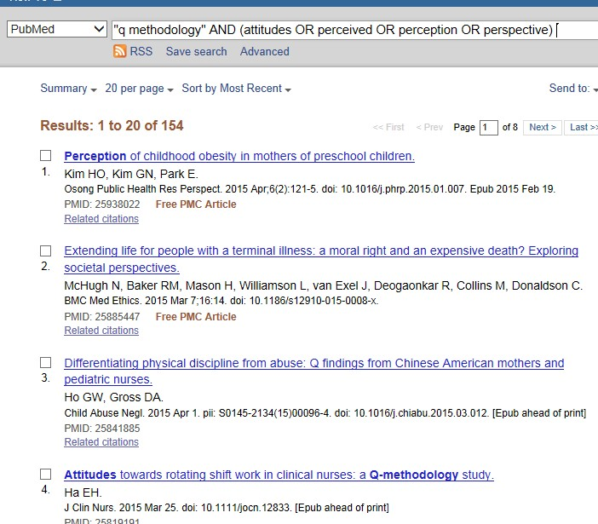

Slide 44
And we know that without the coral, there's a gap in the oceans quality
و بدانیم که پیش از مرجان، خلائی بود در اندیشه دریاها
تقدیم به روح بزرگ استاد گرانقدر مرحوم دکتر حمید راهی

