Slide 1

Notes:
با عرض سلام و خیر مقدم

Slide 2


Slide 3


Title:
A Structural Model of Determinates of Social-Cognitive Theory to Predict Physical Activity in Iranian Women with Type 2 Diabetes
By:
Mehrsadat Mahdizadeh^{1*}, NooshinPeyman², Fatemeh Khorashadizadeh³

Slide 4


Background:
Lifestyle-modification programs including physical activity (PA) have been shown to prevent of type 2 diabetes (T2D). Despite the posi­tive effects of PA on different dimensions of diabetics’ health, most diabetic patients have low levels of mobility compared with nondiabetic individuals.

Slide 5

To develop relevant policies and effective interventions, it is necessary to identify the factors that can be changed to PA behavior. The Social Cognitive Theory (SCT) attempts to introduce behavior predictors and also how to motivate and enable people to adapt to health promoting behaviors, and reduce inability in them.

Slide 6
The objective of this study is :
to present a SEM to predict SCT on PA for empirical analysis of situations that involve multiple interrelationships among several composites, and to determine the strongest social-cognitive factors, demographic and medical variables of PA behavior among women with type 2 diabetes.

Slide 7
Methods:
In this cross-sectional study, partial least square path modeling
(PLS-PM) was used as an estimation technique for structural equation model.
A random sample of 300 women with T2DM was selected, and completed SCT constructs instrument.
Tools used in the study were:
(a) demographic questionnaire (patients’ records were used to complete some of its questions .
(b) The short form of International Physical Activity Questionnaire (IPAQ)
(c) The related questionnaire to SCT constructs.
Data were analyzed using statistical software WarpPLS Ver. 4.0.

Slide 8
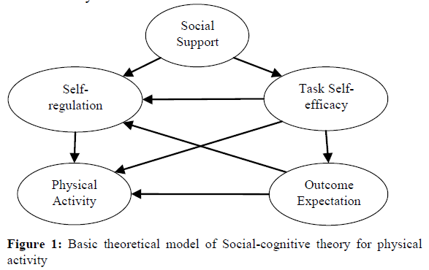
Data analysis:
Applying SCT and constructs cited in the literature, and demographic variables, a model developed to predict PA behavior (see Figure 2). This model is consisted with theoretical models (Figure 1) in previous studies, which provide a theoretical framework for this study.

Slide 9
Results:
Participants
Participants had the mean of age 52.49 ±7.12 years, body mass index (BMI) 30 ±4.17, and hemoglycolized hemoglobin (A1C) 7.67 ±1.68, and the median of diabetes duration, 48 months.

Slide 10

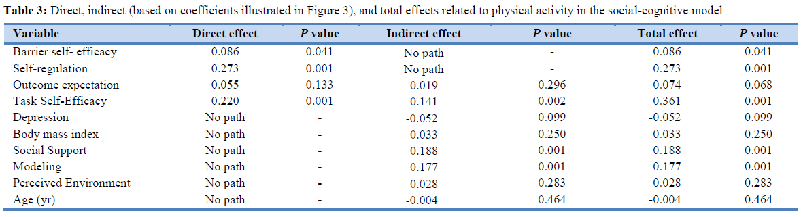

Slide 11
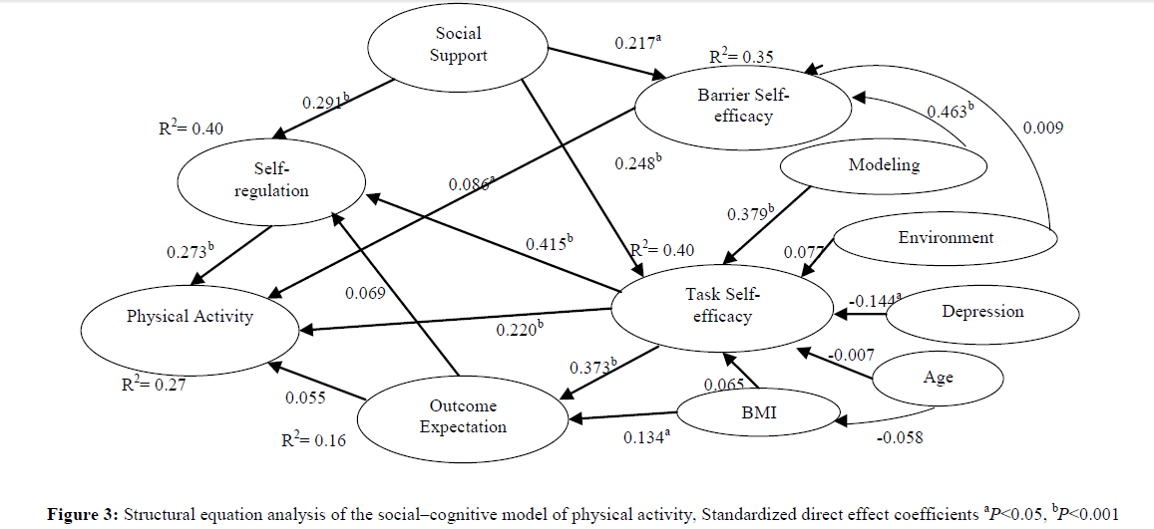

Slide 12
.
Self-regulation, task self-efficacy and barrier self-efficacy were significantly direct predictors of physical activity among women with T2DM. Task self-efficacy, social support and modeling had significantly indirect effects on physical activity behavior.

Slide 13
Conclusions:
The present, Structural equation analysis showed an overall good fit between the proposed model and the data.
Evaluation of the Structural Model
The measurement model resulted in a good model fit (APC=0.189; P<0.001), (ARS=0.264; P<0.001), (AARS=0.256; P<0.001, AVIF=1.129, AFVIF=1.506, GOF=0.433, SPR=0.947, RSCR=0.998.
This theoretical framework can be used to predict physical activity behavior and effective interventions among women with type 2..

Slide 14

Tanks for attention

