Slide 1



Slide 2
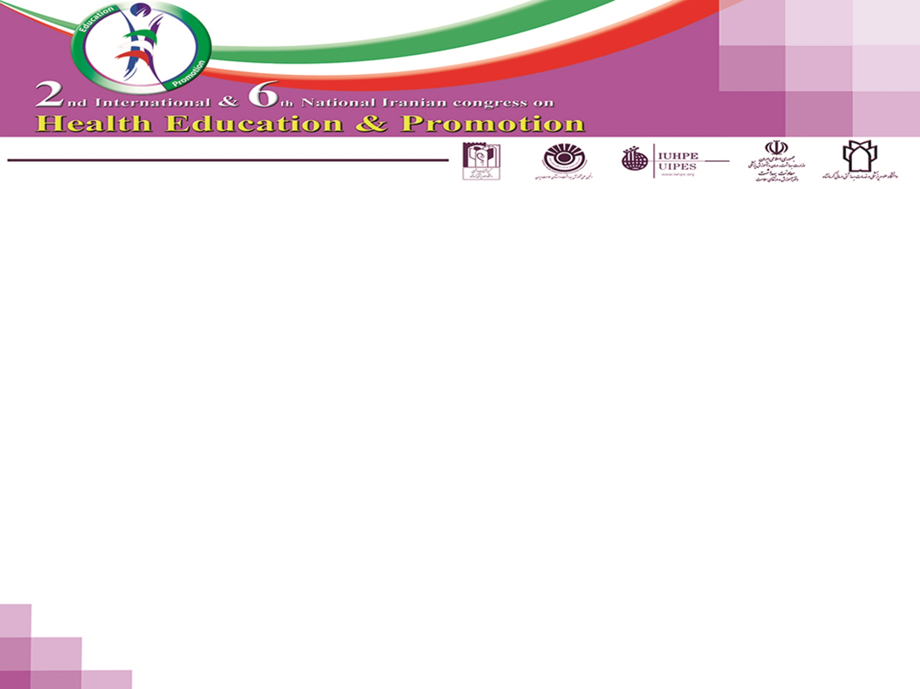
Title: Predicting physical activity behavior among ICU nurses based on a Trans theoretical model using path analysis
By:Saghi Moosavi (MSN)1,Rabiollah Farmanbar (Ph.D) *2 ,Saghar Fatemi (M.D)3,Mohamad Ali Yazdani Pour (BS)4, Mozghan Rahimigilchalan (MSc Student)5
1 MSc in nursing education, Department of Nursing, Faculty of Nursing and Midwifery, Guilan University of Medical Science and health services, Guilan, Iran
² *Associate Professor, Department of Health Education and promotion, Social Determinants of Health Research Center(SCHRC) School of Health, Guilan University of Medical Sciences, Rasht, Iran.
3MD, Guilan University of Medical Science and health services, Guilan, Iran
4 BS in Statistic, Faculty of Nursing and Midwifery, Guilan University of Medical Science and health services, Guilan, Iran
5 BS in Nursing of Guilan University of Medical Sciences , MSc Student in Health Education & Promotion, Medical Science Faculty ,Science and Research branch Islamic Azad University,Tehran ,Iran

Slide 3
Introduction
Regular physical activity has several physical, psychological and social benefits for all ages. Besides, physical activity is an important factor to prevent and treat chronic diseases, especially in lowering the risk of chronic disease . It reduces the risk of many diseases and conditions such as arterial hypertension, diabetes mellitus type 2, dyslipidemia, obesity, coronary heart disease, chronic heart failure and chronic obstructive pulmonary disease. In addition, the risk of colon, breast, and possibly endometrial, lung as well as pancreatic cancer will also be lessened. Generally, increasing PA helps minimize the burden on health and social care through enabling healthy ageing .

Slide 4
Introduction
In spite of the fact that the health benefits of regular physical activity (PA) have been well-established , physical inactivity is a global health issue. Much of the world's population is inactive, so this link presents a major public health issue. Evidence supports the conclusion that physical inactivity is one of the most important public health problems of the 21st century, and may even be the most important. yet at least half of the populace fails to meet national recommended guidelines. As a result, the promotion of PA is of great importance to public health.
The literature from the middle east shows high levels of physical inactivity among adults. Despite the health threats posed by inactivity, data from three national surveys among Iranian adults have shown that more than 80% of Iranian population is physically inactive.

Slide 5
Introduction
Despite the wealth of evidence supporting the positive impact of exercise on health, the majority of nurses do not commit to sufficient regular PA, especially those nurses who play a substantial role in the care provided in ICUs. It has been confirmed that nurses specialized in working for ICUs have a great impact on saving patients’ lives.
Nurses have professional responsibility to patients, they also have the opportunity to be role models, suggesting the attitude that nurses need to exercise more.
However, another related challenge for ICUs is to improve nurses’ quality of working life (QWL). Improving nursing QWL is critical because poor QWL leads to high nursing turnover, a significant problem for ICUs in the United. Consequently, it is important to investigate factors that influence nurses’ decisions about choosing to be active. Gaining a clearer understanding of these factors can provide insight into strategies that may encourage nurses to be active.

Slide 6
Introduction
One of the most popular models for studying behavioral determinants is the Trans Theortical Model (TTM) . According to this model, a special health behavior develops over time and progresses through five stages which may be used to examine readiness and stay physically active :precontemplation, contemplation,preparation, action, and maintenance .The Transtheoretical Model (TTM) is based on the premise that people are at different stages of readiness for engaging in health behaviors, and that intervention approaches are likely to be the most helpful when they are matched to the individual’s current stage of change.
TTM consists of four key constructs including Stages of Change, Processes of Change, Self Efficacy, and Decisional Balance.

Slide 7
Introduction
There is evidence of cultural variation in style, and the meaning of activity and psychological constructs. Therefore, it is imperative to determine the external validity of those research findings before adopting findings across nations and cultures. There for this study filled a critical void in our knowledge and helped to determine the efficacy of the TTM to explain exercise behavior among nurses who work in ICUs.
Accordingly, the aim of this study was to determination the relationship between TTM constructs (processes of change, decisional balance and self efficacy) and exercise behavior using path analysis among ICU nurses of Guilan university of medical sciences.
.

Slide 8
Method
Study: cross sectional study.
Participants : 82 nurses who work in ICUs of Guilan university of medical
Instruments: stage of exercise behavioral change questionnaire , Global Physical Activity Questionnaire, Exercise Processes of Change Questionnaire, Exercise Self-Efficacy Scale , Decision Balance Scale for Exercise.
Statistical analysis: bivariate correlation was used to examine the relationship between variables . The proposed model was explored using path analysis in LISREL 8.80. Model fit was assessed using a number of fit indexes.

Slide 9
Results
Findings showed that 97.6% of participants were female.92.8% were married They were studying at two levels (B.Sc. and M.Sc.), including ( 92.8% )B.Sc., (7.2%)M.Sc. (68.7%)lived in apartments. 57.8% had physical activity in the past and (66.3%) of them had physical activity history in their family members. Also, 13.3% of samples had history of musculoskeletal disorders.

Slide 10
Correlations for the TTM constructs
5 6 7 | 4 | 3 | 2 | 1 | Constructs
 |  |  |  | 1 | SOC
 |  |  | 1 | 0/067 | MET
 |  | 1 | 0/027 | 0/115 | CPOC
 | 1 | **0/603 | 0/032 | **0/291 | BPOC
1 | **0/573 | **0/337 | ** 0/2 | **0/4 | SE
** 0/413 1 | **0/542 | **0/603 | 0/146 | 0/062 | PROS
** 0/202 0/071 1 | **0/661 | **0/228 | -0/078 | 0/12 | CONS
2/26 3/58 2/11 | 3/03 | 3/508 | 2/35 | 2/33 | Min
0/95 1/04 0/95 | 0/84 | 0/62 | 4928/8 | 1/24 | SD

Slide 11
Revised TTM to predict physical activity behavior in nurses
0/03
0/18
0/38
0/11
Revised TTM to predict physical activity behavior in nurses.
CPOC
SOC
0/59
BPOC
0/54
SE
0/24
MET
0/63
0/18
PROS
CONS

Slide 12
Fit index of the path model
Chi-Square | DF | Chi-Square/DF | GFI | AGFI | NFI | CFI | RMSEA | SRMR
6/33 | 5 | 1/27 | 0/98 | 0/95 | 0/96 | 0/99 | 0/06 | 0/05

Slide 13
Conclusion
Self-efficacy and Pros were the most efficient factor for physical activity among the given samples of the study. Moreover, self-efficacy and behavioral process of change had an direct effect on the stage of exercise change. Since self-efficacy had both direct and indirect effect on ICU nurses’ physical activity, it is as the strongest physical activity predictive factor.
In summary we can say that these kinds of studies support and strengthen the theoretical framework and reinforcing the idea of the transtheoretical model as a logical and coherent explanation statistically established on physical activity. It is obvious, experimental studies like randomized control trials will be able show using of TTM based intervention effect on promoting and maintenance of physical activity.

Slide 14
Refferences
Hutchison AJ, Breckon JD, LH., J., 2009. Physical activity behavior change interventions based on the transtheoretical model: a systematic review. Journal of Health Education and Behavior 36 (5), 829-845.
Fei Sun, Ian J Norman, While, A.E., 2013. Physical activity in older people: a systematic review BMC Public Health 13, 449.
Ayse P Gurses, Pascale Carayon, Melanie Wall, 2009. Impact of Performance Obstacles on Intensive Care Nurses‘ Workload, Perceived Quality and Safety of Care, and Quality of Working Life, . Health Service Research 44 ((2 Pt 1)), 422–443.
Blair S.N, 2009. Physical inactivity: the biggest public health problem of the 21st century. Br J Sports Med 43 (1), 1-2.
Younh-Ho., K., 2007. Application of The Transtheoretical Model to Identify Psychological Constructs Influencing Exercise Behavior: A questionair Survey. Int J Nurs Stud 44, 936-944

Slide 15
Refferences
Moattari M, Shafakhah M, R, S.S., 2013. Assessing Stages of Exercise Behavior Change, Self Efficacy and Decisional Balance in Iranian Nursing and Midwifery Students. IJCBNM 1 (2), 121-129.
Mohsen MM, Saafan NA, Attia A, A, E.-A., 2014. Lifestyle Behavior Modification of Mothers of Diabetic Children’s through Application of Transtheoretical Model of Change. . J Nurs Care 3, 153. doi:110.4172/2167-1168.1000153.
Kang SJ, Kim SC, YH., K., 2012. Korean older Adults Physical Activity and Its Related Psychosocial Varieables. Journal of Sports Science and Health 13 (3), 89-99.
Prochaska JO, R edding CA, KE., E., 2008. The transtheoretical Model and stage of change. In K. Rimer& F.M.Lewise(Eds).Health behavior and health education. Theory, Research and Practice: San Francisco. Jossey- Bass Publishers.

Slide 16

Questions

