Slide 1
Title: The relationship between self –efficacy, coping skill and substance use in adolescent: based on Structural equation modeling
By: Zohre Fathian Dastgerdiª, Ahmad Ali Eslami ^{a *}, Fazlollah Ghofranipour^{b}, Firoozeh Mostafaviª,Ali Akbar Ebrahimi^{c}

Slide 2
Substance abuse in adolescent continues to be an important societal problem. It is well-known that regular use of substances during the early years increases the probability of developing a substance use disorder consequently(1).
Substance use in adolescents is related with a number of adverse worries, such as increased medical and mental health problems, disciplinary, absenteeism and problems in school. In some cases, substance abuse can lead to unpremeditated injury and even death(2).

Slide 3
An inclusive range of factors have been found to have an influence on adolescent substance use(3).
The conception of self-efficacy has played a crucial role to understanding of substance use behaviors in adolescent.
Self-efficacy represents a personal resource factor that may facilitate coping strategies (7). In literature on addiction it is defined as coping Self-efficacy.
Coping, includes helping persons learn and practice proper coping mechanisms to deal with high-risk situations.
The failure to cope adequately could lead to decreased self-efficacy and a higher probability of substance use or relapse. On the other hand, individuals can enhance their confidence or self-efficacy, if they could cope with these high-risk situations, thus decreasing the probability of substance use(8) .

Slide 4
Strengthening of coping self-efficacy predisposes to create an adaptive approach leading individuals to view tasks or situations that require high efforts as challenging and as positive experiences.
Thus, beliefs about one’s ability to perform specific coping behaviors, or CSE, would be anticipated to influence the outcomes of interventions designed to advance coping.
Strong evidence are available that confirmed self-confidence in avoiding substance use in high-risk situations is a supporting key factor in reducing substance use risks (17-20).

Slide 5
Coping skill
Refusal Self -efficacy
Substance use
These findings support the notion that it is important to measure coping self-efficacy related to substance use .Moreover, to our knowledge, a few published studies have specifically examined the relationship between coping, refusal self-efficacy and substance use.
Therefore, on the basis of these considerations, the main purpose of the present study was to gain more insight in the relationships between refusal self –efficacy and coping skill in a sample of adolescents through explain the direct and indirect effects, to examine the ways in which each may contribute to substance use behavior as a hypothesized model (Fig. 1)

Slide 6
Material and methods
2.1. Participants
A self-administered questionnaire was completed by 720 girls and boys, aged between 14-18, involved in a cross-sectional study, using stratified, two-stage, cluster sampling, based on the population of different areas of Isfahan.
Prior to completing the questionnaires ethical approval for the project was obtained from the committee of faculty members and ethics committee of Isfahan Medical University. The questionnaires were filled in convenience and the samples were adolescents present in public places such as parks, café-nets, gyms and public passages.
Participants were informed of the voluntary nature of their participation, that they could withdraw at any time prior to submitting their responses, and that to preserve anonymity no identifying information would be collected. Consent was implied by completion of the questionnaires and participating gifts were given to all the participants. Each questionnaire completion took approximately 25 min.

Slide 7
2.2. Measures
2.2.1. Refusal self-efficacy questionnaire with four questions on the ability of a person to refuse drug consumption in situations like having parties with new people, stressful situations like school exams and celebrations. Internal consistency was analyzed in the last study and Cronbach’s alpha coefficient that reached 0.85 was considered reliable (22).
2.2.2. Decision-making skills questionnaire with 5 questions, each with four Likert type options and Cronbach’s alpha coefficient computed to be 0.69.
2.2.3. Assertiveness questionnaire included five questions with four options from strongly agreed to strongly disagreed measures in Likert type. Cronbach’s alpha coefficient calculated to be 0.74.
2-2-4. Communication skills questionnaire contained six questions with four options in Likert measures. Cronbach’s alpha coefficient computed to be 0.89.
2.2.5. Substance use questionnaire included tobacco, alcohol, cannabis and hard drugs such as opiates and industrial drug including ecstasy, LSD, Crystal, etc. with using in a lifetime, 12 months or 30 days. Measures in Likert type were with 7 options from never to 30 times or more.

Slide 8
2.3. Procedure
A two-step approach (23) was undertaken to evaluate whether the hypothesized model fits the data or not.
First, a first order measurement model was examined to assess how well the observed measures reflect the latent constructions based on goodness-of-fit indices, this would suggest that items were representative of their corresponding constructs.
Second, the hypothesized model was tested to examine the relationships among constructs. The predictive model was specified as follows: decision-making, assertiveness and communication skill were specified to predict its respective second order latent indicators as coping skill. Then refusal self-efficacy and coping skill were set to predict the behavior.

Slide 9
Result:
3.2. Measurement model
Four latent variables were specified in the first order measurement model (Fig. 2). The refusal self-efficacy contained four observable variables and had loadings ranging from .84 to .90. The decision-making contained four observable variables and had loadings ranging from .71 to .84. The assertiveness factor contained five observable variables and had loadings ranging from .60 to .74 and communication skill contained five observable variables and had loading ranging from .65 to .86.
Interpretation of the factor loadings was based on the guidelines set forth by Comrey and Lee (26). They suggested the loadings greater than 0.71 should be considered excellent, 0.63 very good, 0.55 good, and 0.45 fair and 0.32 poor. Accordingly, we had acceptable factor loadings in our model

Slide 10
The latent variables from the first order confirmatory model had acceptable indices (table1) and were significantly inter-correlated.
Table1. First order confirmatory models
 | CMIN | DF | CMIN/df | TLI | CFI | PNFI | RMSEA
Refusal self-efficacy | 3.2 | 1 | 3.2 | .98 | .99 | .16 | .08
Communication skill | 3.01 | 2 | 1.5 | .99 | .99 | .2 | .07
Assertiveness | 2.3 | 1 | 2.3 | .95 | .99 | .16 | .07
Decision-making skill | 3.1 | 1 | 3.1 | .94 | .99 | .16 | .07
Chi-square values are significant (p < 0.05). S-B χ2=Satorra–Bentler Chi-square; NFI = Normed Fit Index; CFI =Comparative Fit Index;
TLI= Tucker Lewis index ; RMSEA =root mean square error of approximation.

Slide 11
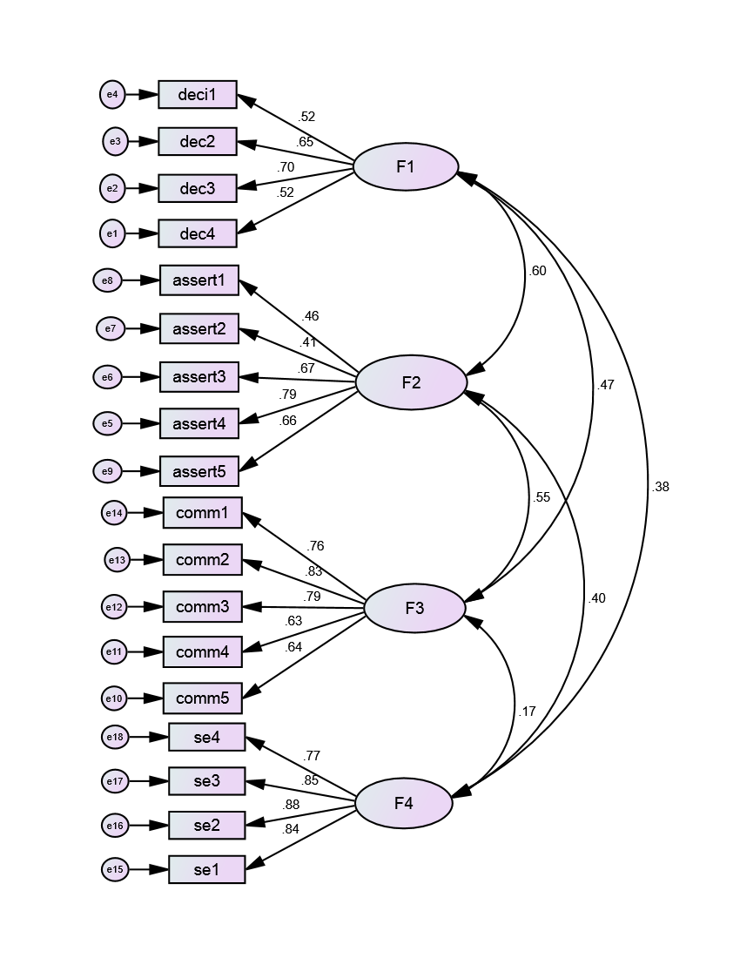
Fig. 2. First order Measurement model F1=decision-making skill, F2= assertiveness skill, F3=communication skill, F4=refusal self-efficacy

Slide 12
Reliability analyses showed acceptable internal consistency and stability for all subscales.
The Cronbach’s alpha value was 0.86 for the total scale and ranged from 0.68 to 0.89 for the four subscales. The corrected item total correlation coefficients ranged from 0.40 to 0.74.
Reliability with split-half method also indicated an acceptable internal consistency for coping self-efficacy scale in this study (Spearman-Brown =0.64)

Slide 13
SEM analyses
The second order confirmatory model(Fig 2) had ten endogenous observed variables concerning subscales, each with its error component and two latent variables relating to coping, and refusal Self-efficacy constructs that linked in a further observed endogenous variable.

Slide 14
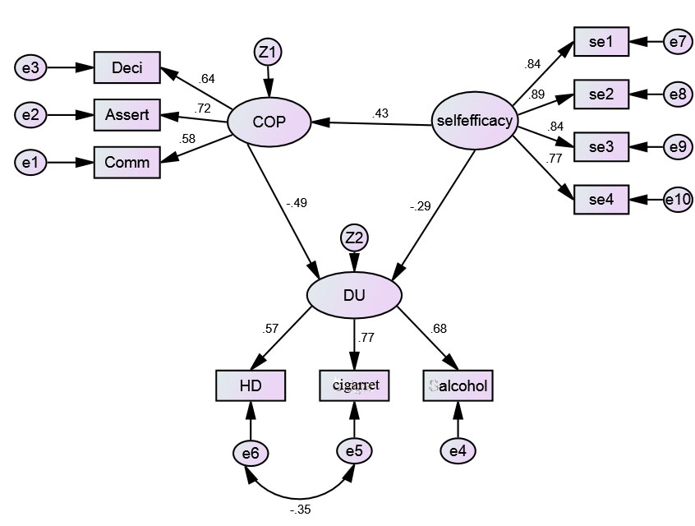
Fig. 2: Direct and indirect paths standard coefficients for the effect of self-efficacy on substance use mediated by coping skill.
CMIN=146.02,DF=31,P<.001,CMIN/DF=4.7,NFI=.95,TLI=.94,CFI.96, PNFI=.65, RMSEA=.07 (90% CI: 06-.080)

Slide 15
A path analysis tested the research hypotheses, and results supported the hypotheses.
The self-efficacy has a positive direct correlation with coping skill(r=.43) and negative correlation with substance use(r=-.29). The coping skill was mediated on the relationship between self-efficacy and substance use.
Total causal direct and indirect effect of independent variables on substance use was 98%, of which 77% of the direct effects is related to coping skills and refusal self-efficacy and 21% is of indirect effect of self -efficacy on substance use that was mediated by the coping skill. Refusal self –efficacy had stronger effect on coping (r=.49) in comparison with substance use (r=.29). Therefore, the indirect path from self -efficacy to coping skill and substance use was more acceptable path and could significantly predict the substance use behavior (p<001).

Slide 16
Discussion:
The findings in the present study are consistent with those of many other research studies. Annis & Davis confirmed that low coping self-efficacy was strongly associated with an absence of perceived internal control over alcohol use. This relationship between lack of perceived control over the use and a lack of confidence in being able to cope may have important implications for addiction treatment. Some cognitive behavioral treatment programs have described the development of intervention strategies designed to increase a client’s perceived control over substance use while fostering enhanced coping self-efficacy (30, 31).

Slide 17
In explaining the results on the relationship between self-efficacy and coping skill in regulating human behavior, Bandura (1997) believes that self-efficacy expectations are one of the foremost factors (6).
Individuals with a low self-efficacy avoid doing tasks perceived to be higher than their ability, which causes failure in problem solving that in turn, reduces self-efficacy, leading to a vicious circle.
Bandura (1997) also struggles that such individuals have easy feasible goals, but poor commitment to their goals. Thus this may account for the lower commitment for act of health behaviors in individuals with low self-efficacy(6).

Slide 18
Perceived self-efficacy may not only have a direct influence on the choice of activities and conditions, but also through final success expectations that it can influence coping efforts at the outset.
Bandura (1997) believes that self-efficacy perceptions regulate emotional states in numerous ways: Individuals who believe they can control threats have low problems when facing one and those with low self-efficacy are more likely to overstate threats. Individuals with high self-efficacy reduce their stress and anxiety through actions that reduce the threat of environment and those with higher coping abilities can control damaging thoughts.

Slide 19
Self-efficacy has a fundamental role in defining behavior and functioning as it influences the perception of the stressfulness level of a situation and hence the experiences of emotions, coping challenges, psychological well-being and functioning in an individual (34)Self efficacy represents a personal resource factor that may facilitate effective coping.
Self-efficacy makes a modification in how people feel, think, and act (4, 35). In order to understand the effective mechanisms that allow self-efficacious persons to cope better than others, one has to accept that self-efficacy is a competence-based, optimistic and prospective construct. Coping is viewed as the mediator between personal resources and outcomes such as affect, well-being, and quality of life (7).

Slide 20
The direct pathway suggested that, coping skill was a dominant predictor of substance use behavior among the adolescents.
It is consistent with Bussey Rask study that Coping skills have found to be significant predictors of alcohol consumption (35) and according to Donovan & Chaney), inadequate coping skills have been associated with an increased likelihood of drug use and relapse(36, 37). These other characteristics may serve as moderators that affect changes in coping styles and self-efficacy, which, in turn may affect long-term outcomes such as drug use and criminal behavior(38)

Slide 21
. Conclusion
The results, revealed stable assessment of four confirmed factors including: decision-making, assertiveness, refusal self-efficacy and communication skill and also demonstrate strong support for the construct validity in the first order measurement model. The results confirmed our hypothesized model, in which the relationship between refusal self-efficacy and substance use would be mediated by coping skill, and that this relationship could significantly predict substance use behavior. To address this issue, future longitudinal studies should be repeated to confirm the findings and to gain a better understanding of the relationship between those factors and substance use in adolescents

Slide 22
Thank you

