Slide 1
Development and Validation of Elder’s Satisfaction Questionnaire for patients Attending Dental Clinics
By:
Marjan Haghi
PhD student in Gerontology
University of Social Welfare and Rehabilitation Sciences, Tehran, Iran

Slide 2
Introduction
Quickly aging populations constitute a critical issue health care deliveries.
Nearly one-third of persons 65 years of age and older have untreated dental problems.
Slightly more than one-half of noninstitutionalized persons 65 years of age and older had a dental visit in a year.
Improving patients' satisfaction with oral health and dental clinics is essential in all age.

Slide 3
Objective
Develop a validate and reliable questionnaire for elder`s satisfaction assessment of oral and dental care.

Slide 4
Methods
This is a Methodological research.
A content analyses of :
qualitative interviews with elderly patients &
items from existing dental satisfaction questionnaires
were used to develop our questionnaire.

Slide 5
Methods
The psychometric properties of the questionnaire in terms of face validity, content validity, and construct validity were assessed.
The five-point Likert scale was used to design questionnaire.
The items were administered to 188 elders (age>=60 years old) at the dental clinics.
Exploratory and confirmatory factor analysis was down by using SPSS 18 and AMOS 8.0, respectively.

Slide 6
Results

Slide 7
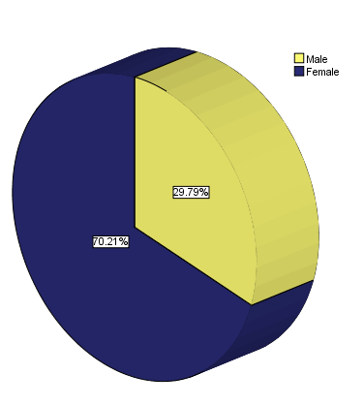
Results

Slide 8
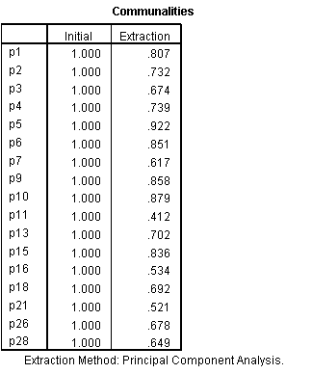
Factor Analysis

Slide 9
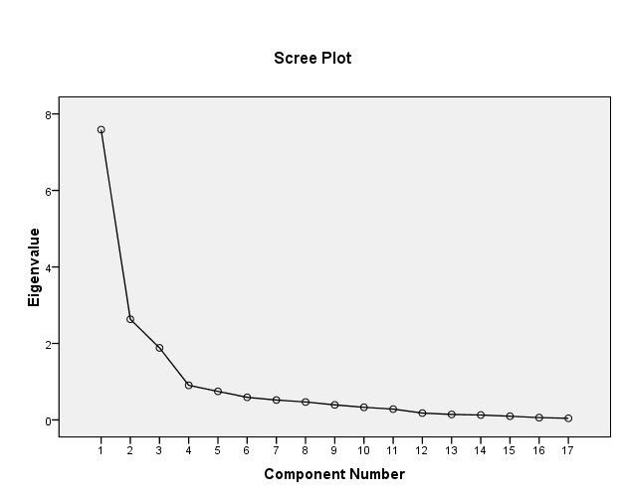
Scree plot

Slide 10
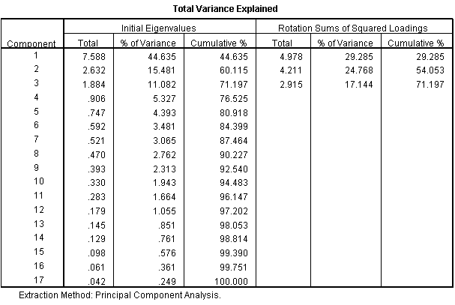
Variance explanation

Slide 11
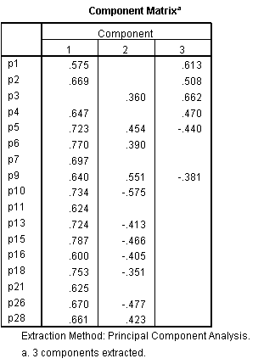
Component Matrix

Slide 12
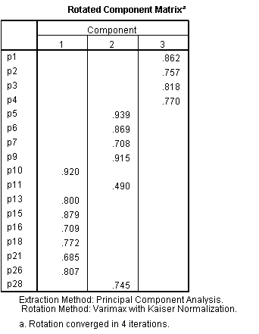
Rotated Matrix

Slide 13
Results
The questionnaire with 17 items were administered to 94 elders (age>=60 years old) at the dental clinics.
Confirmatory factor analysis was down by using AMOS 8.0.
The fitness of model was evaluate by parsimony indices, absolute indices and …

Slide 14
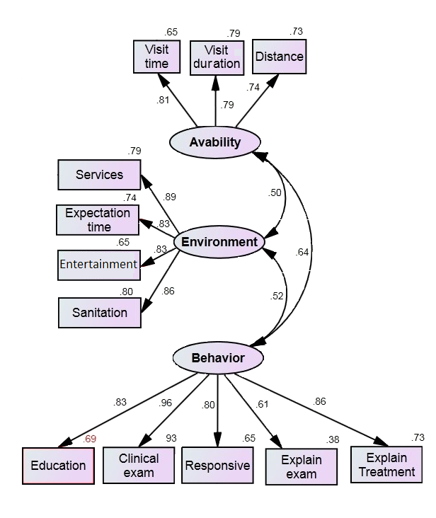
Results

Slide 15
Results
Model Fit Summary
Model | NPAR | CMIN | DF | P | CMIN/DF
Default model | 29 | 62.940 | 49 | .087 | 1.284
Saturated model | 78 | .000 | 0
Independence model | 12 | 801.892 | 66 | .000 | 12.150

Slide 16
Model | RMR | GFI | AGFI | PGFI
Default model | .082 | .902 | .844 | .566
Saturated model | .000 | 1.000
Independence model | .539 | .318 | .194 | .269

Slide 17
Parsimony-Adjusted Measures
Model | RMSEA | LO 90 | HI 90 | PCLOSE
Default model | .055 | .000 | .092 | .392
Independence model | .346 | .325 | .368 | .000
Model | RMSEA | LO 90 | HI 90 | PCLOSE
Default model | .055 | .000 | .092 | .392
Independence model | .346 | .325 | .368 | .000

Slide 18
Reliability
The final instrument with 12 items representing three dimensions of patient satisfaction was developed.
Three items assessing satisfaction with availability of services (Cronbach's alpha = .92).
Four items assessing satisfaction with environmental conditions of clinic (Cronbach's alpha = .87).
Five items assessing satisfaction with dentist behavior (Cronbach's alpha = 0.82).

Slide 19
Conclusion
This study has validated a new instrument assessing elder`s satisfaction of oral and dental care.
The multidimensional structure of instrument allows to be used as a clinical tool for improving satisfaction of patients by appropriate interventional programs.

Slide 20
END

