Slide 2
Effectiveness of interactive web-based lifestyle program on prevention of cardiovascular diseases risk factors in patient with metabolic syndrome: a randomized controlled trial (The Red Ruby Study)
Leila Jahangiry
Assistant Professor; Tabriz University of Medical sciences

Slide 3
Cardiovascular diseases (CVD) are the leading cause of mortality and morbidity worldwide.
It is argued that metabolic syndrome is the most responsible risk factor for developing the disease.

Slide 4
In Iran, it affects approximately one-quarter of population and has become a leading health concern due to its link to cardiovascular diseases .
Metabolic syndrome has been identified by central obesity, increased triglycerides, reduced high-density lipoprotein cholesterol (HDL), hypertension, and elevated fasting blood glucose concentration .

Slide 5
Although effectiveness of lifestyle interventions on prevention of cardiovascular diseases risk factors are recognized, the potential of web-based programs on prevention of cardiovascular diseases risk factors has not been explored.

Slide 6
This study was conducted to determine the effectiveness of interactive web-based technology on lifestyle intervention in a population with metabolic syndrome.

Slide 7
Method: This is a two-arm randomized controlled trial. The study includes 160 participants (n = 80 per arm) who was recruited via online registration on the study website.
The inclusion criteria are that they should have metabolic syndrome and have access to the Internet.
All participants received information on dietary intake and physical activity through the study website.

Slide 10
The intervention group received additional resources via the study website including interactive Healthy Heart Profile and calorie restricted diet tailored to the participants.

Slide 11
My Healthy Heart Profile

Slide 12
The primary outcomes were the change in metabolic syndrome components.
The secondary outcomes were comparing physical activity and food intake among the study arms.
The participants were followed up to 6 months and data collection scheduled at baseline and 6 months.

Slide 13
Results: The mean age of participant was 44.2 years (SD=10.0). There were no significant differences between the intervention and the control groups on any of baseline variables.
Although we found reduction in cardiovascular diseases risk factors in the both intervention and control groups, these reductions were significantly greater in the intervention group in six months follow up.

Slide 14
The intervention group showed higher significant reductions in systolic blood pressure (at three months: -10 vs. -6 mmHg; and at six months: -11vs. -8 mmHg), diastolic blood pressure (at 3-months: -10 vs. -4 mmHg; and at six months: -11 vs. -6 mmHg), weight (at three months: -2 vs. -1 Kg; and at six months: -4 vs. -1 Kg), body mass index (at three months: -0.5 vs. -0.2 Kg/m²; and at six months: -1.1 vs. -0.4 Kg/m²) and improvement in HDL-cholesterol (at three months: 2 vs. 0.64 mg/dL; and at six months: 6 vs. 4 mg/dL) (P <0.05 for all).

Slide 15
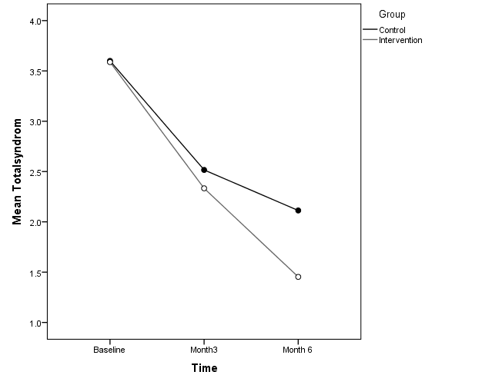

Slide 16
Discussion: The findings from this web-based interactive randomized controlled trial showed that a 6-months lifestyle intervention was able to change several metabolic syndromes in a favorable direction.

Slide 17
Our findings provided evidence for the beneficial impact of an Internet-based program on significant changes in systolic and diastolic blood pressure at six months follow-up.
Web-based interactive programs may motivate participants to adhere better to clinical assessments and desired behaviors such as physical activity and healthy diet.

Slide 18
Conclusion: The findings suggest that the web-based interactive program was beneficial for prevention of cardiovascular diseases on individuals with metabolic syndrome.

Slide 19
Research Team:
Dr. Leila Jahangiry
Prof. Ali Montazeri
Prof. Davoud Shojaeizadeh
Dr. Mahdi Najafi
Prof.Kazem Mohammad

Slide 20
Thanks

