Slide 1
In the name of Allah

Slide 2
Development and psychometric Testing of a new Instrument to Measure Affecting Factors on Women’s Behaviors to Breast Cancer Prevention: an exploratory mixed method study
By:
Maryam Khazaee
Ph.D in health education and promotion, Tehran University of Medical Sciences

Slide 3
Background
Breast cancer is the most common female type of cancer and the leading cause of cancer death in women.
It is the first common cancer diagnosed in Iranian women.
Approximately it affects Iranian women 10 years earlier than women in developed countries.

Slide 4
Background
Though breast cancer incidence in Iran is partly low (about 23.65 per 100,000), the number of cases recently diagnosed is increasing
Because of the unknown of the main causes of breast cancer, preventive behaviors include: changing lifestyle and doing screening behaviors (mammography, clinical breast examination and breast self-examination) are suitable way in breast cancer prevention and early detection.

Slide 5
Background
so, we thought it is necessary to identify factors to perform breast cancer preventive behaviors in traditional societies such as Iran.
A review of the related literature did not show any study on scale development intended to identify the factors affecting women’s breast cancer preventive behaviors, which was the motive for conducting the present study.

Slide 6
Therefore, the present study aims to develop and examine the psychometric properties of a newly developed scale in order to identify factors that are associated with women’s behaviors towards breast cancer prevention and perhaps indicate areas for implementing interventions to improve preventive behaviors among women.

Slide 7
Methods

Slide 8
Design
- It was used an exploratory mixed method investigation in this study.
- Study was conducted in two phases.
- Qualitative approach for item generation
- Quantitative approach to assess psychometric properties of the questionnaire

Slide 9
Phase 1: Item generation
we used two qualitative approach, focus group discussions and individual interviews.
Participants and data collection
Women (n = 24) aged 30 and over without breast cancer.
Two focus group discussions as the primary method of data gathering.
16 semi-structured interviews.
Purposive sampling method with maximum variation.
Data analysis
Graneheim and Lundman’s approach
Data were simultaneously collected and analyzed

Slide 10
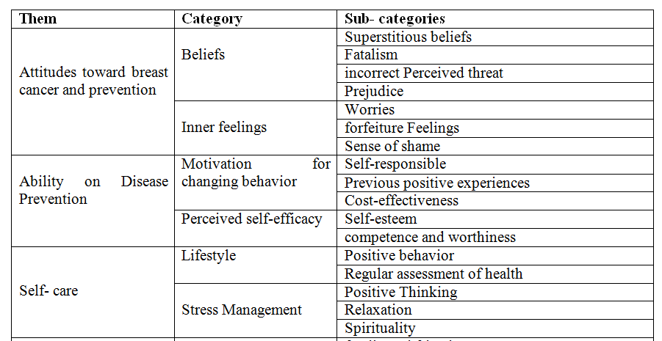
Table 1: Themes and sub-themes identified

Slide 11
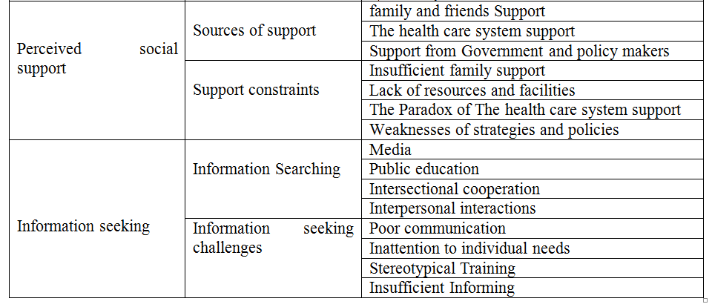
Table 1: Themes and sub-themes identified

Slide 12
Phase 2
psychometric Testing of a new Instrument to Measure Affecting Factors on Women’s Behaviors to Breast Cancer Prevention: an exploratory mixed method study (AFWB-BCPS)

Slide 13
The questionnaire
Developing pre-final draft of the instrument
The first draft of scale contained 58 items and each item is rated on a five-point response scale (always to never).

Slide 14
Statistical analysis
Face validity
Both quantitative and qualitative methods were used for face validity.
A group of women (n=10) were asked to evaluate each item for “ambiguity”, “difficulty”, and “relevancy” in qualitative approach.
Also for quantitative step, a group of same women (n=10) were examined to calculate the impact score (frequency × Importance) to show the importance of each item on a 5-point Liker scale. The impact score of equal or more than 1.5 was considered suitable
In conclusion all items had above 1.5 impact score.

Slide 15
Content validity
Both qualitative and quantitative content validity were used.
In the qualitative stage, the scientific expert panel evaluated the questionnaire for wording, grammar, and scaling.
The content validity index (CVI) and the content validity ratio (CVR) were applied for calculating the quantitative content validity.
Items with CVR score of 0.62 or above were selected acceptable
The CVI score of below 0.8 for each item was no acceptable

Slide 16
Construct validity
Sampling= 250
Exploratory factor analysis:
A principle component analysis (PCA) with varimax rotation.
Eigenvalues above 1 and scree plot were used to specify the number of factors (Figure 1).
The Kaiser-Meyer-Olkin (KMO) and Bartlett’s Test of Sphericity were applied to evaluate the suitability of the sample for the factor analysis.

Slide 17
Reliability
The Cronbach’s alpha coefficient (Values equal 0.70 or above).
test-retest reliability by estimating Intra class Correlation Coefficient (ICC) in which twenty five women 30 and above completed the questionnaire once first and two weeks later.
ICC values of 0.40 or above were thought acceptable.

Slide 18
Results
Participants: 250 women, the mean age of 41.25± 6.34 years.
Face validity: Ranged 1.9 -5.
Content validity: 14 items was deleted respectively with CVR and CVI less than 0.62 and 0.8.
Construct validity: KMO index=0.733, χ2=2180.98, P<0.001
A final 33-item questionnaire loaded on seven factors with eigenvalues greater than 1 and factor loading equal to or higher than 0.4; accounting for 60.62% of variance identified.

Slide 20
Factors
Factor 1 with 5 items (Supportive systems).
Factor 2 with 3 items (Efficacy).
Factor 3 with 7 items (Lifestyle).
Factor 4 with 3 items (Stress management).
Factor 5 with 3 items (Motivation).
Factor 6with 4 items (Information seeking).
Factor 7 with 8 items (Concerns).

Slide 21
Reliability
The internal consistency: Cronbach’s alpha 0.797 (0.689 - 0.850).
The Intraclass Correlation Coefficient (ICC) was found satisfactory, showing good stability for questionnaire that was 0.86 (Table 2).

Slide 22
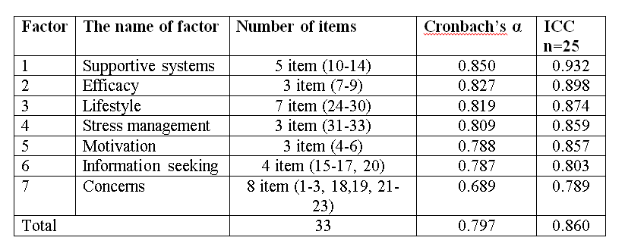
Table 2: Reliability of questionnaire

Slide 23
Conclusion
It was thought developing a scale for assessing factors affecting breast cancer preventive behavior to improve health abstinence might cover this goal and help to improve women’s health.
More studies in different populations of women should be noted to make stronger psychometric properties for the instrument.

Slide 24
Thanks

